Slide 1

Introduction to MACHINE LEARNING: module 1.
Fosca Giannotti
Revisited slides from Lecture Notes for Chapter 7 “Introduction to Data Mining”, 2nd Edition by Tan, Steinbach, Karpatne, Kumar, with insertion from other recommended references-
Slides used within the 2021 edition of course DM&ML master Big Data Analytics, University of Pisa

Slide 2
Supervised Learning: Classification (cnt) Neural Networks (Perceptron)

Slide 3
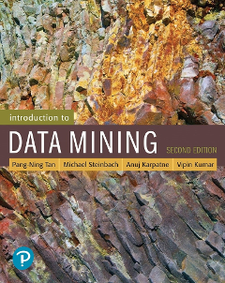


References
Artificial Neural Network. Chapter 5.4 and 5.5. Introduction to Data Mining.
Hands-on Machine Learning with Scikit-Learn, Keras & Tensorflow. A practical handbook to start wrestling with Machine Learning models (2nd ed).
Deep Learning. Ian Goodfellow, Yoshua Bengio, and Aaron Courville. The reference book for deep learning models.

Slide 4

References
Artificial Intelligence: A modern approach, fourth edition
Stuart Russel and Peter Norvig
Chapter 19 and 22

Slide 5
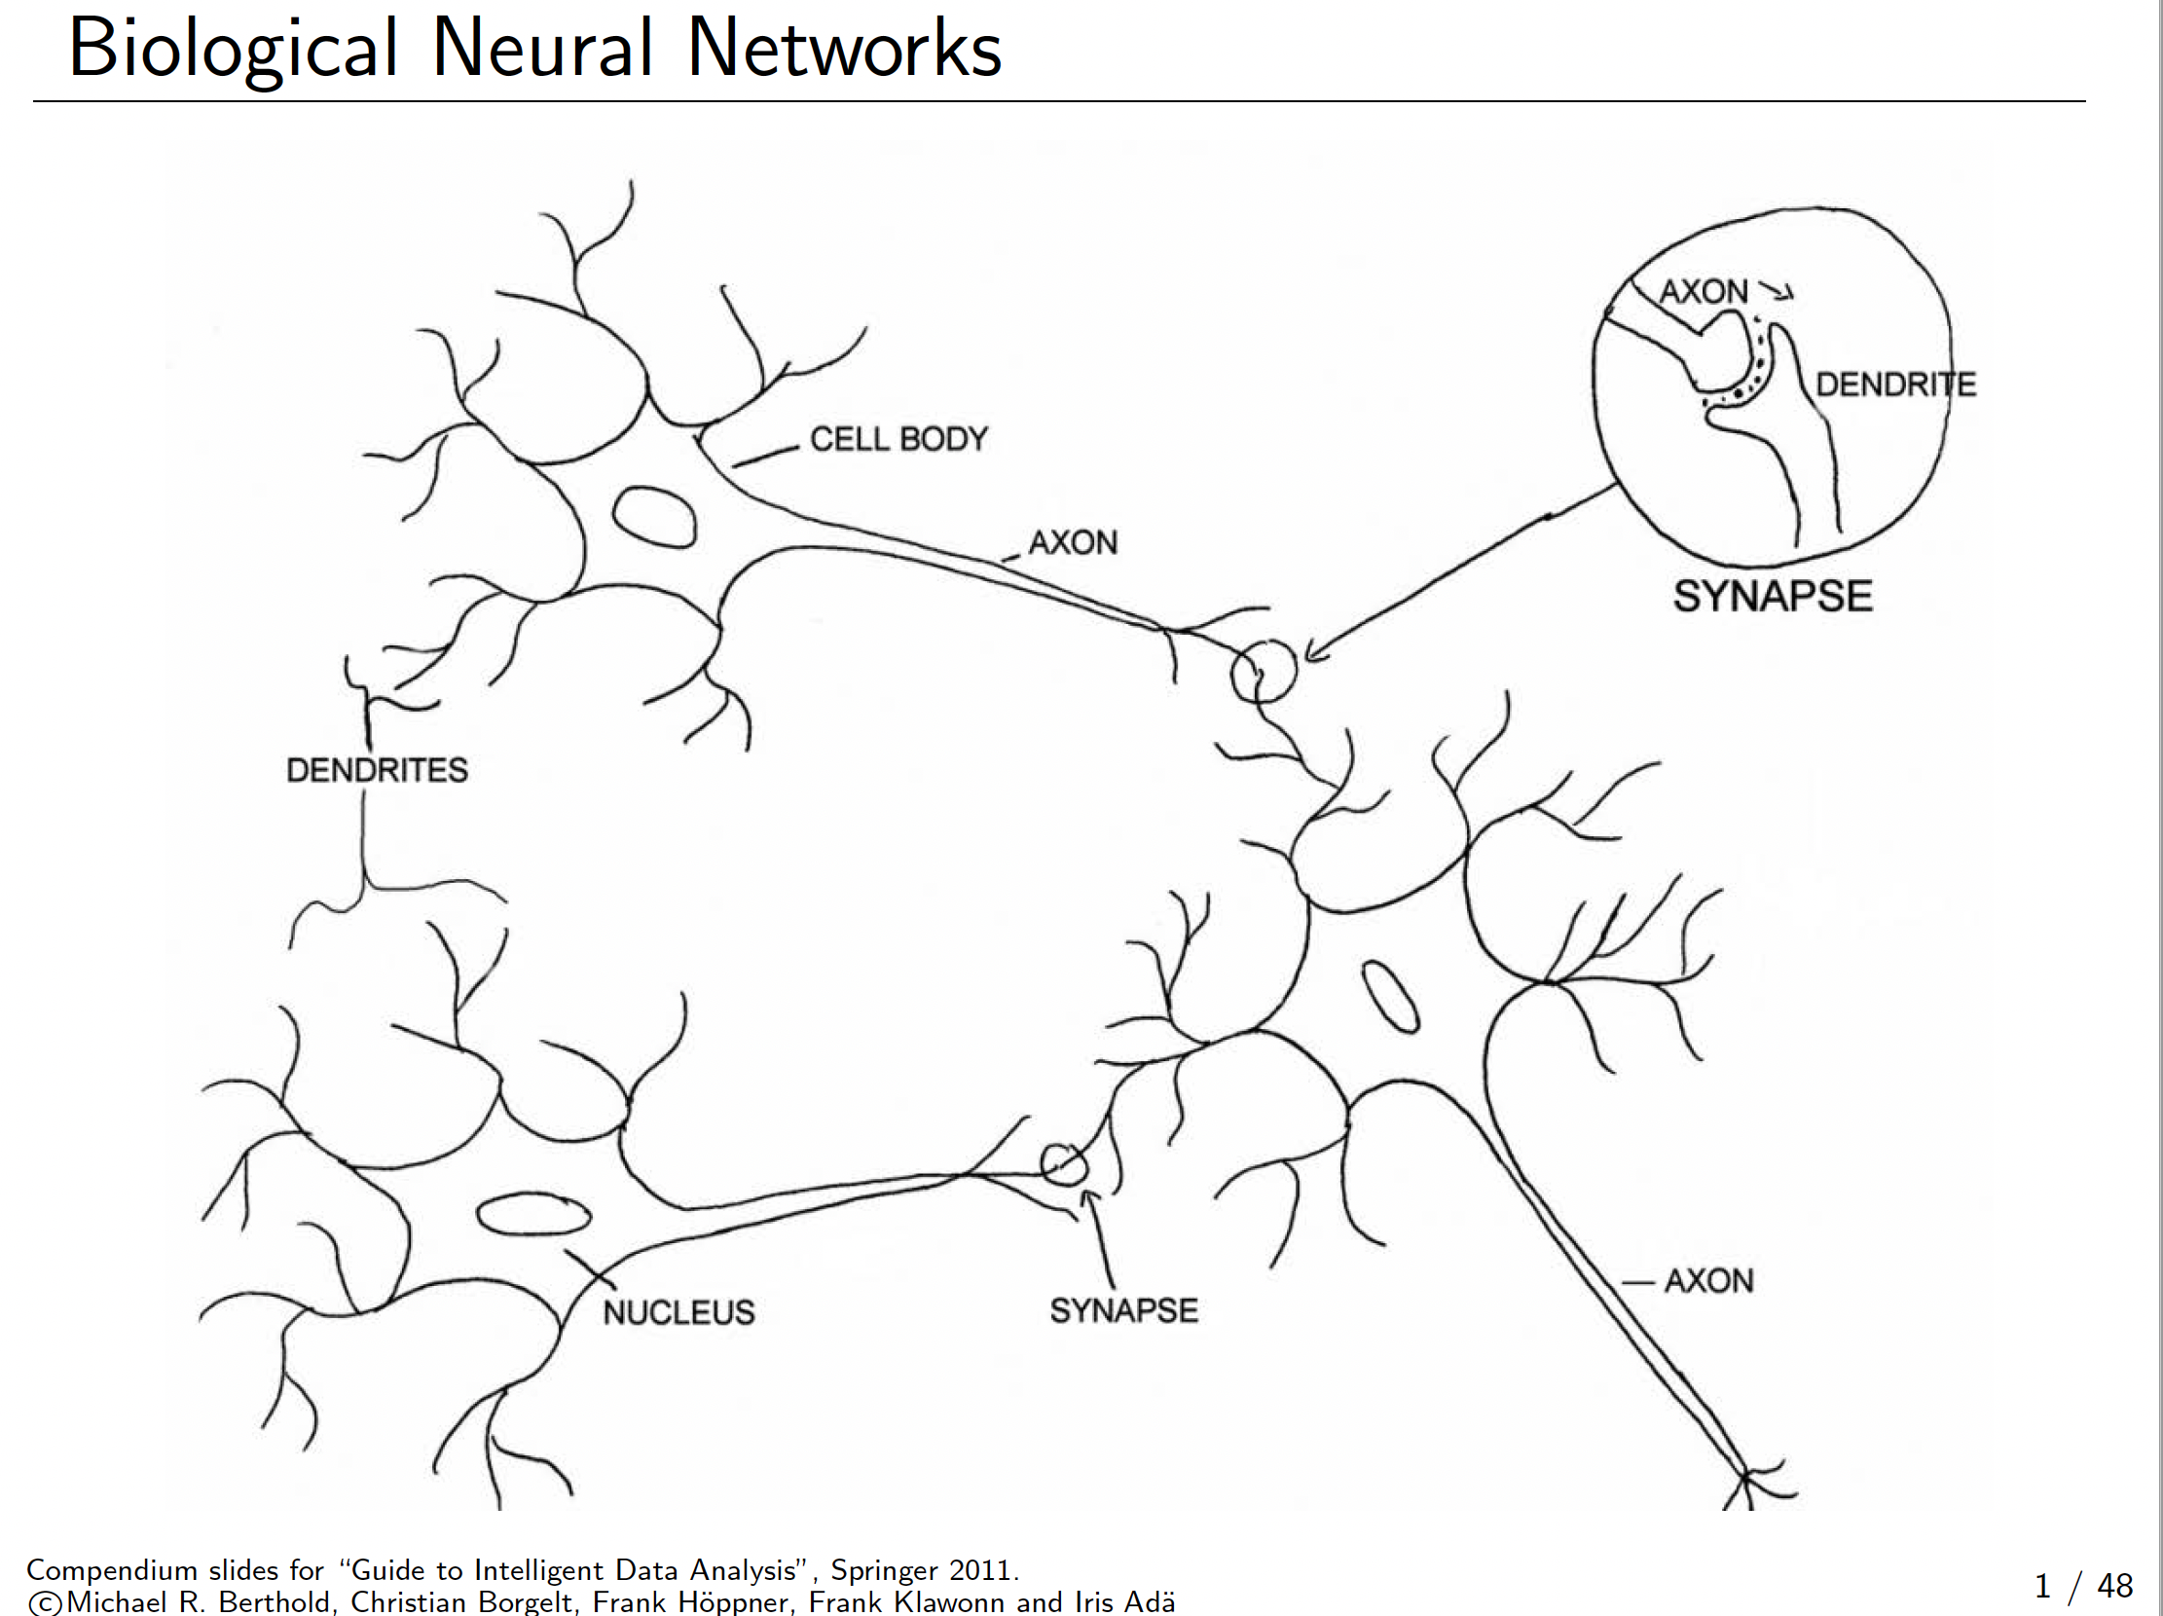
Biological Neural Networks

Slide 6
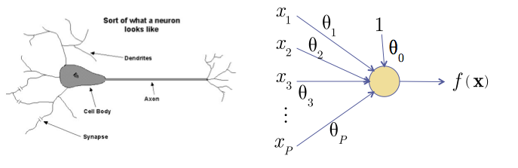
The Neuron Metaphor
Neurons
accept information from multiple inputs,
transmit information to other neurons.
Multiply inputs by weights along edges
Apply some function to the set of inputs at each node
Notes:
The study of ANN was inspired by attempts to simulate biological neural systems.
Neurons are linked through axons that tarnsmits nerve inpulses when stimulated.
A neuron is connected to the axons of other neurons via dendrites which are extnesions for the cell body of neurons.
The contact point between a dendrite and an axon is a synapse.
Human barin learns by changing the strength of the synaptic connection between neurons upon repeated stimulation by the same impulse.

Slide 7
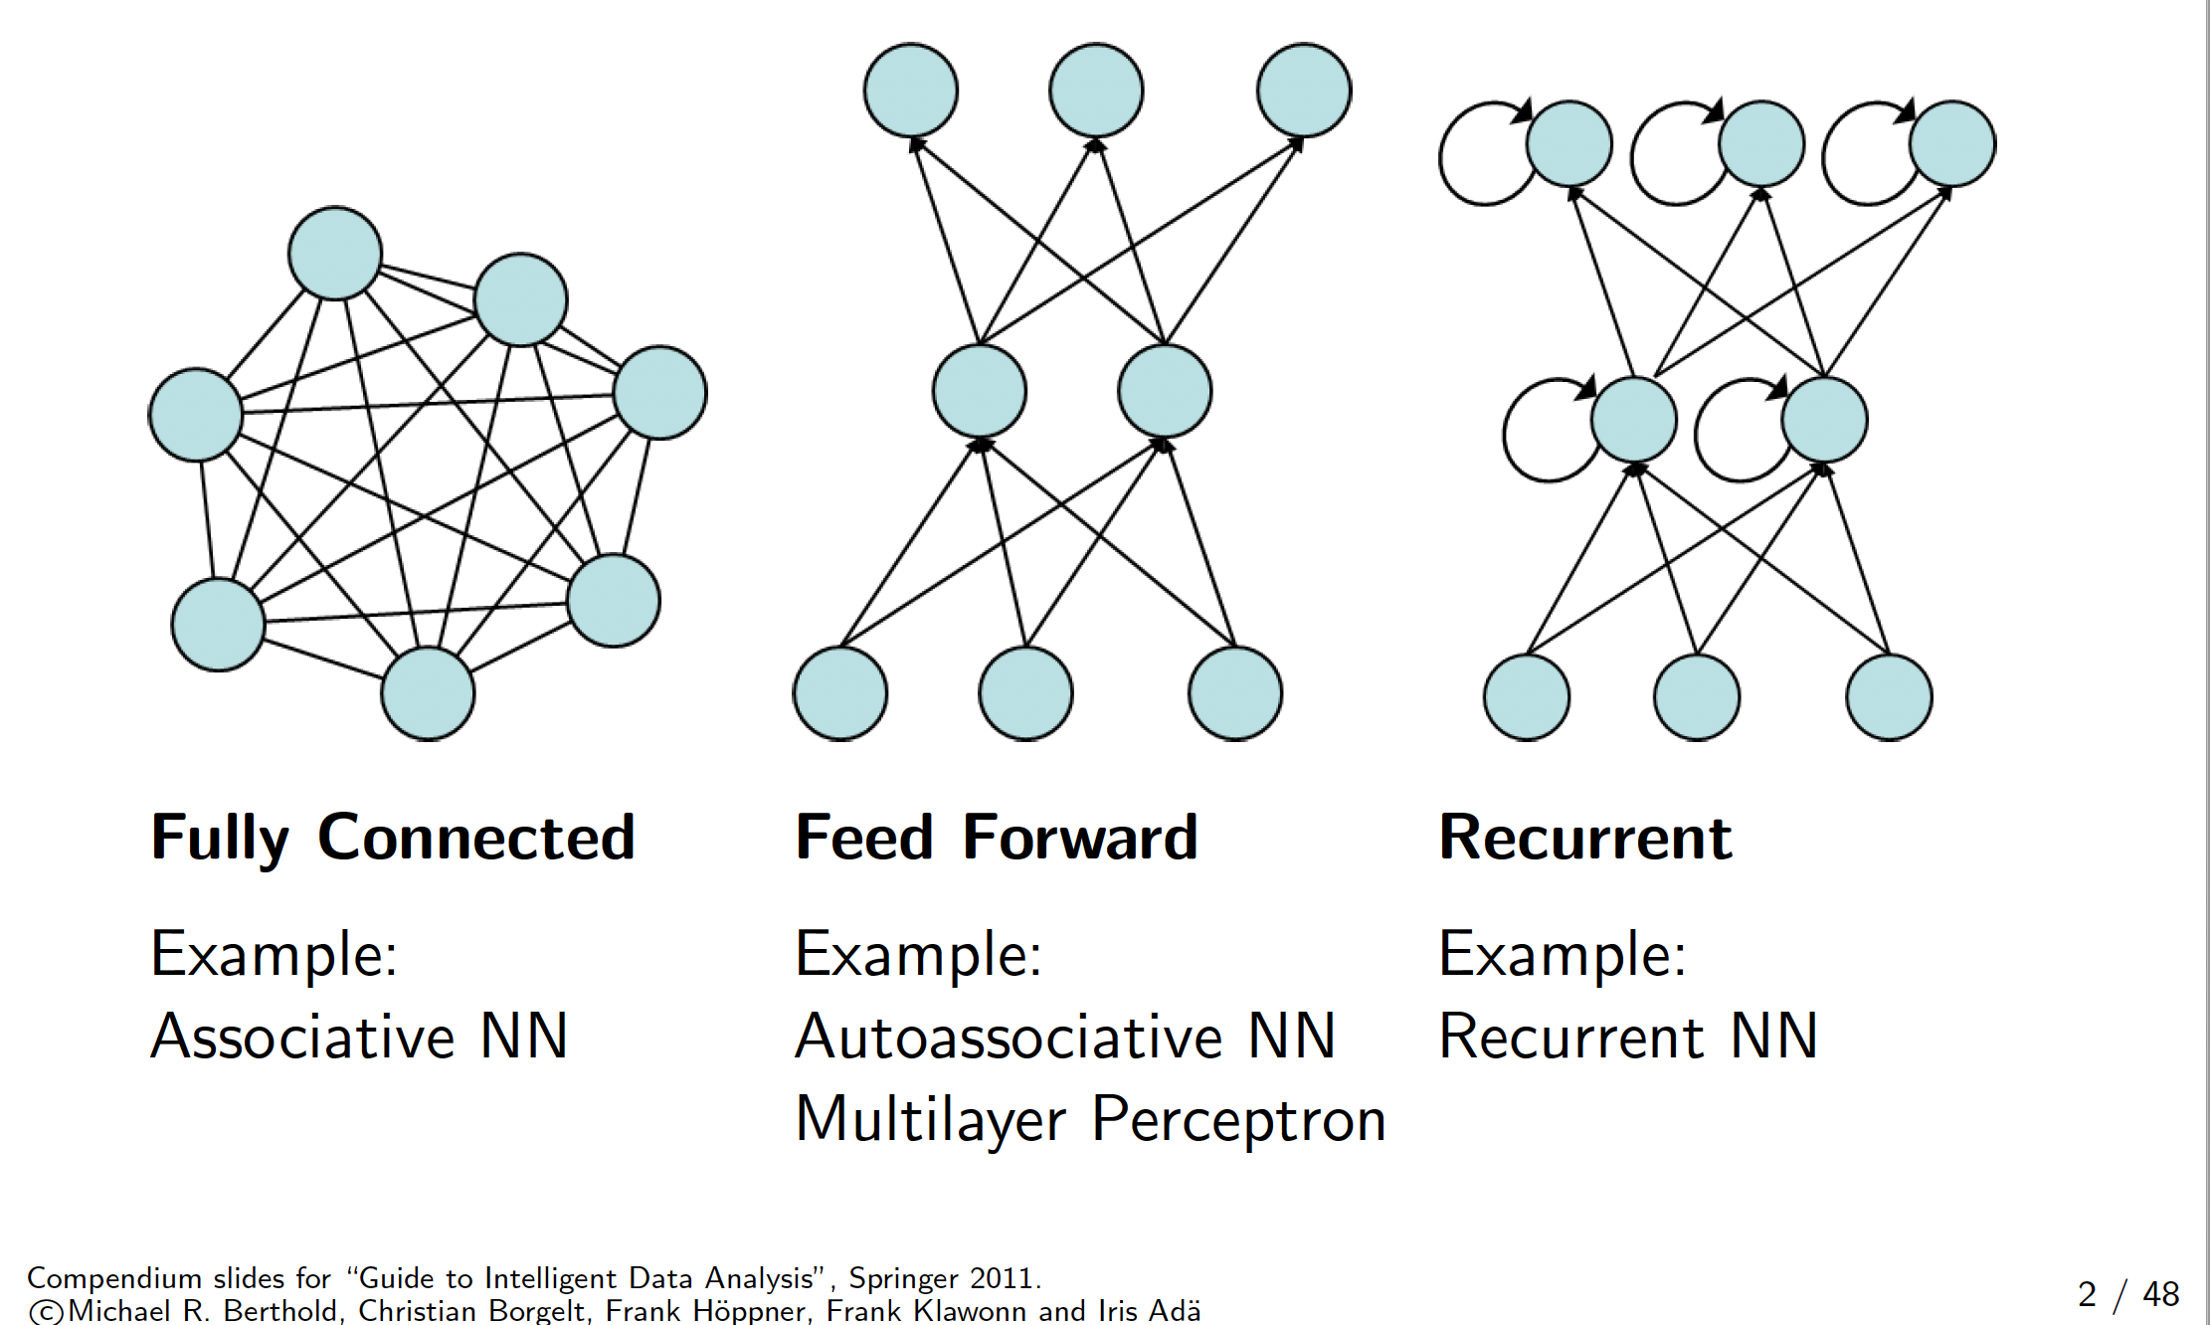

Slide 8
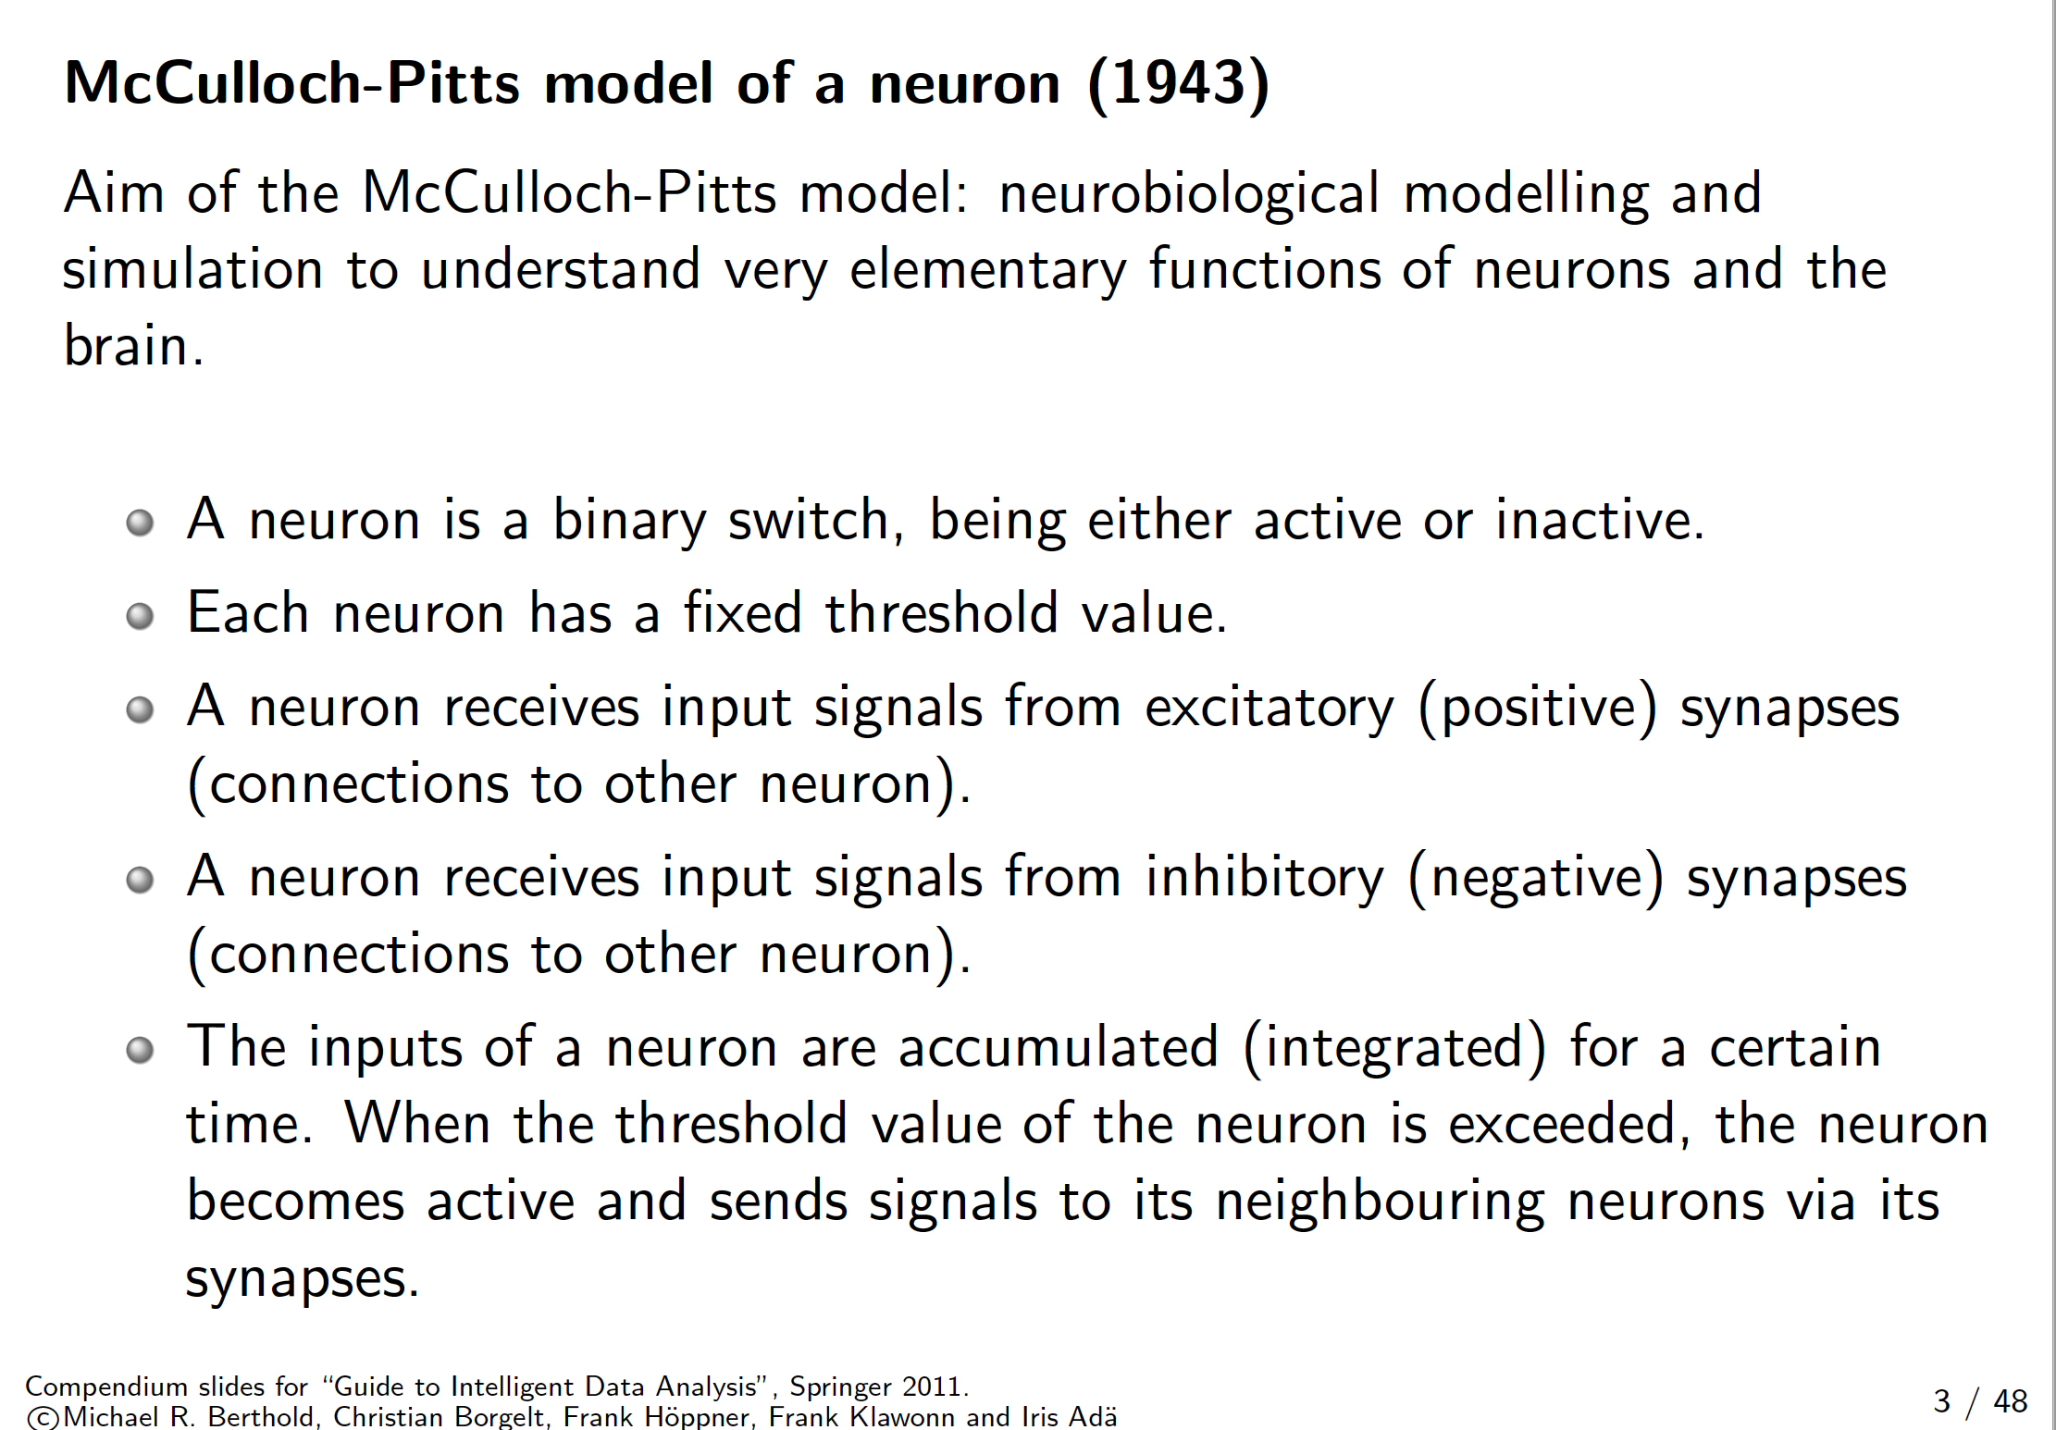
A Neuron

Slide 9
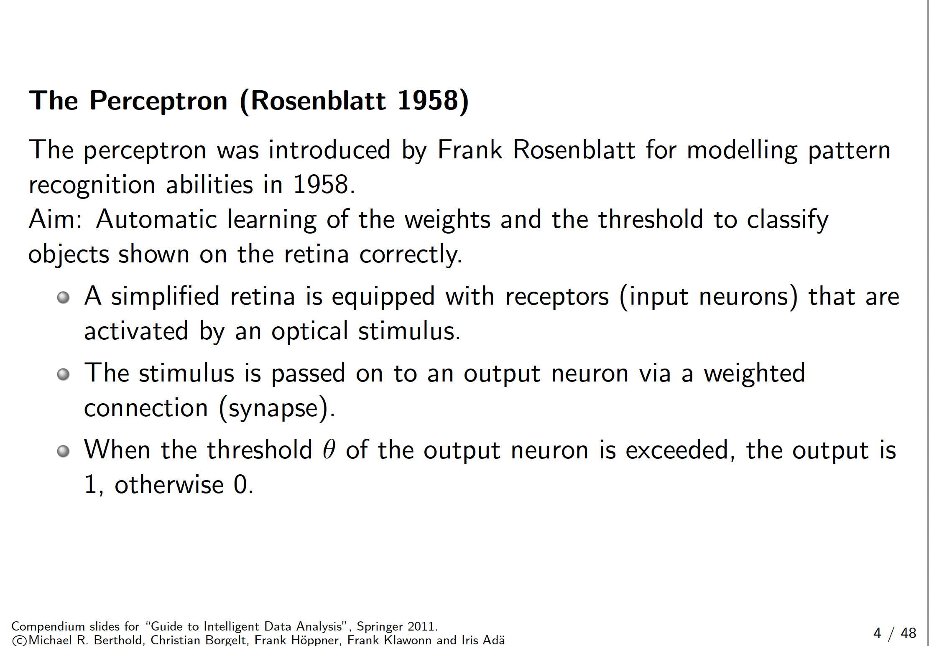
The simple perceptron

Slide 10
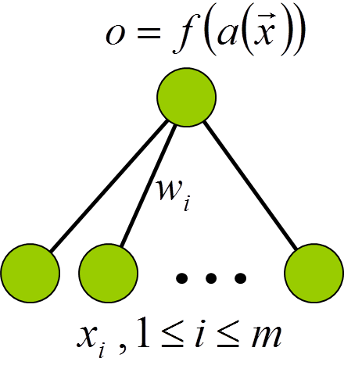

The simple perceptron
Schematic model of a perceptron:
�{
$$\sum_{i=0}^{m}{}$$
1 if a > θ
0 otherwise
a ( x) =
w_{i} · x_{i} o = f (a) =
(Numerical) input attributes A_{i}, output class (0 or 1). Classifier for two-class problem.
For multiclass problems use one perceptron per class.

Slide 11
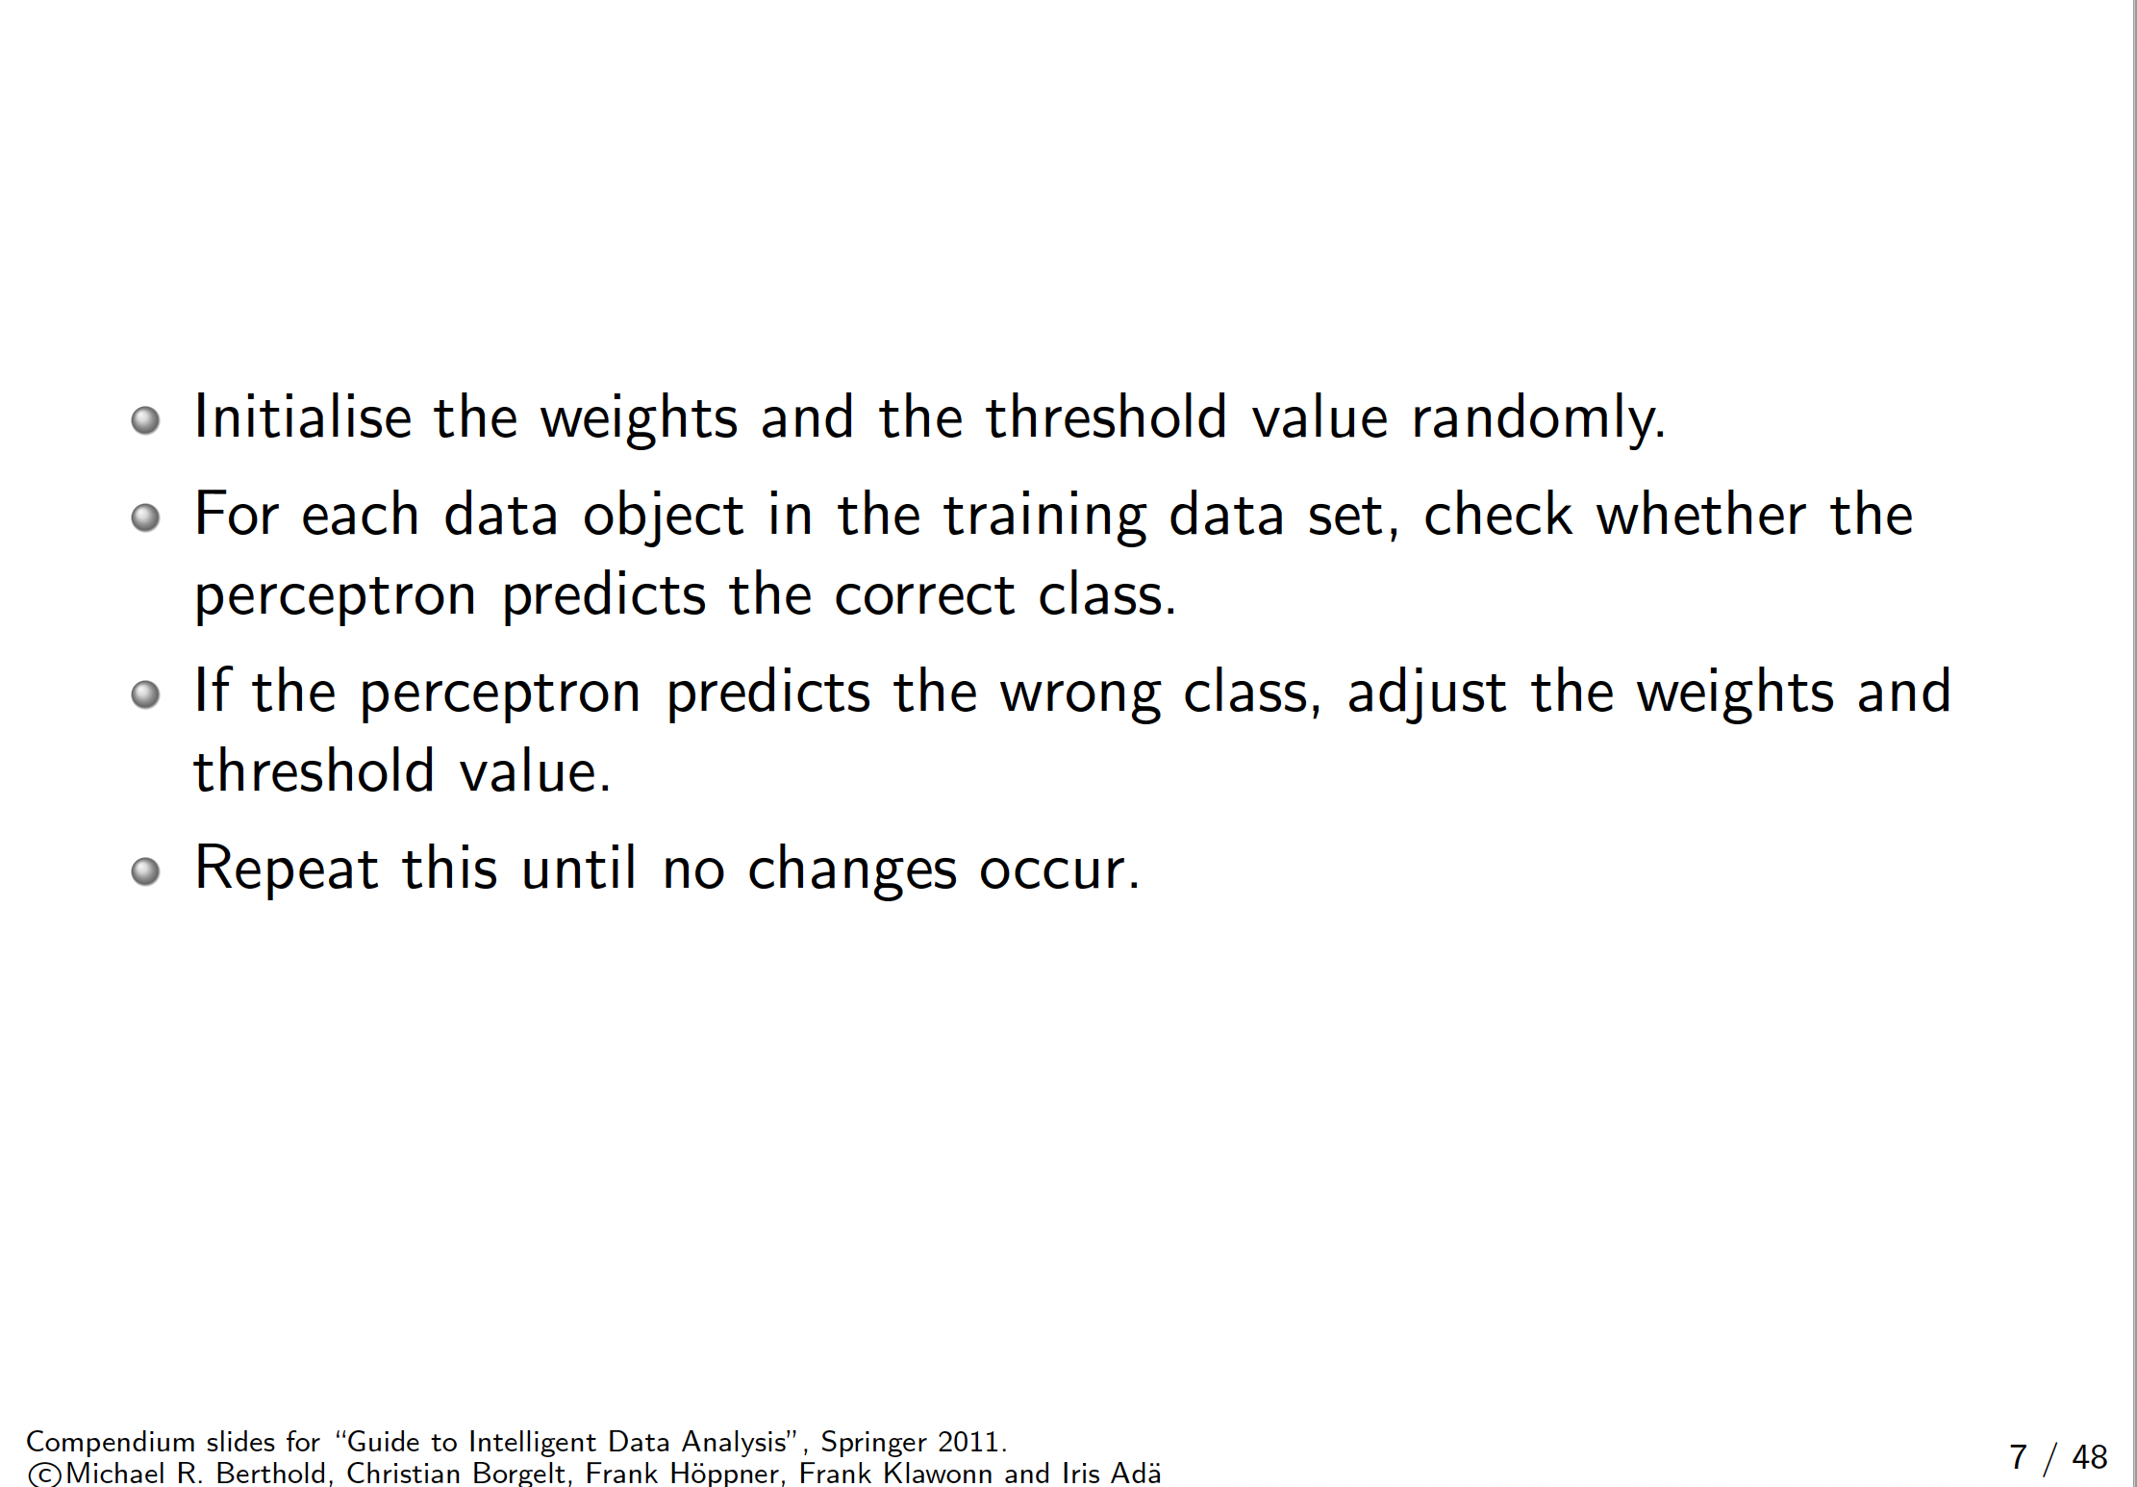
Percetron learning algorithm

Slide 12
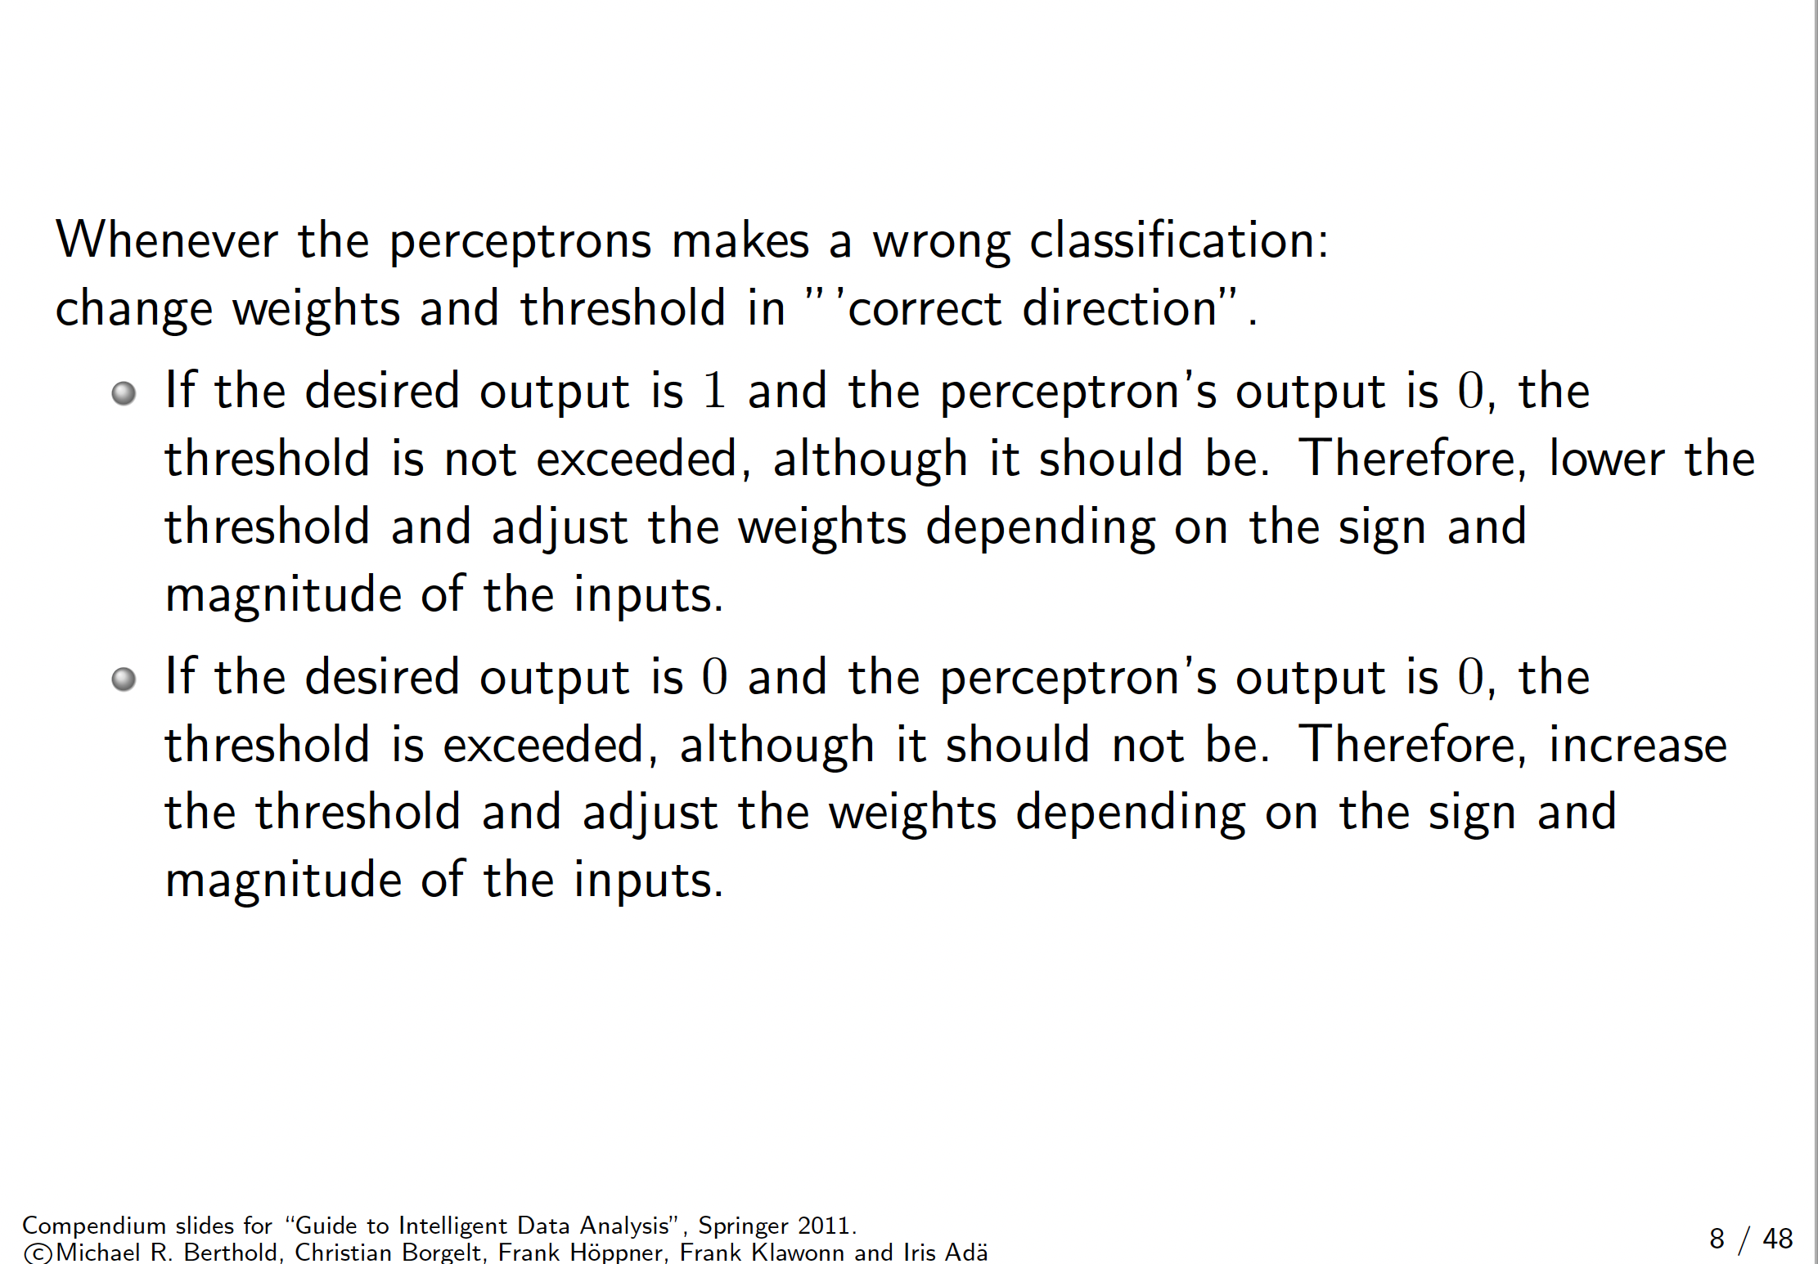
The delta rule

Slide 13
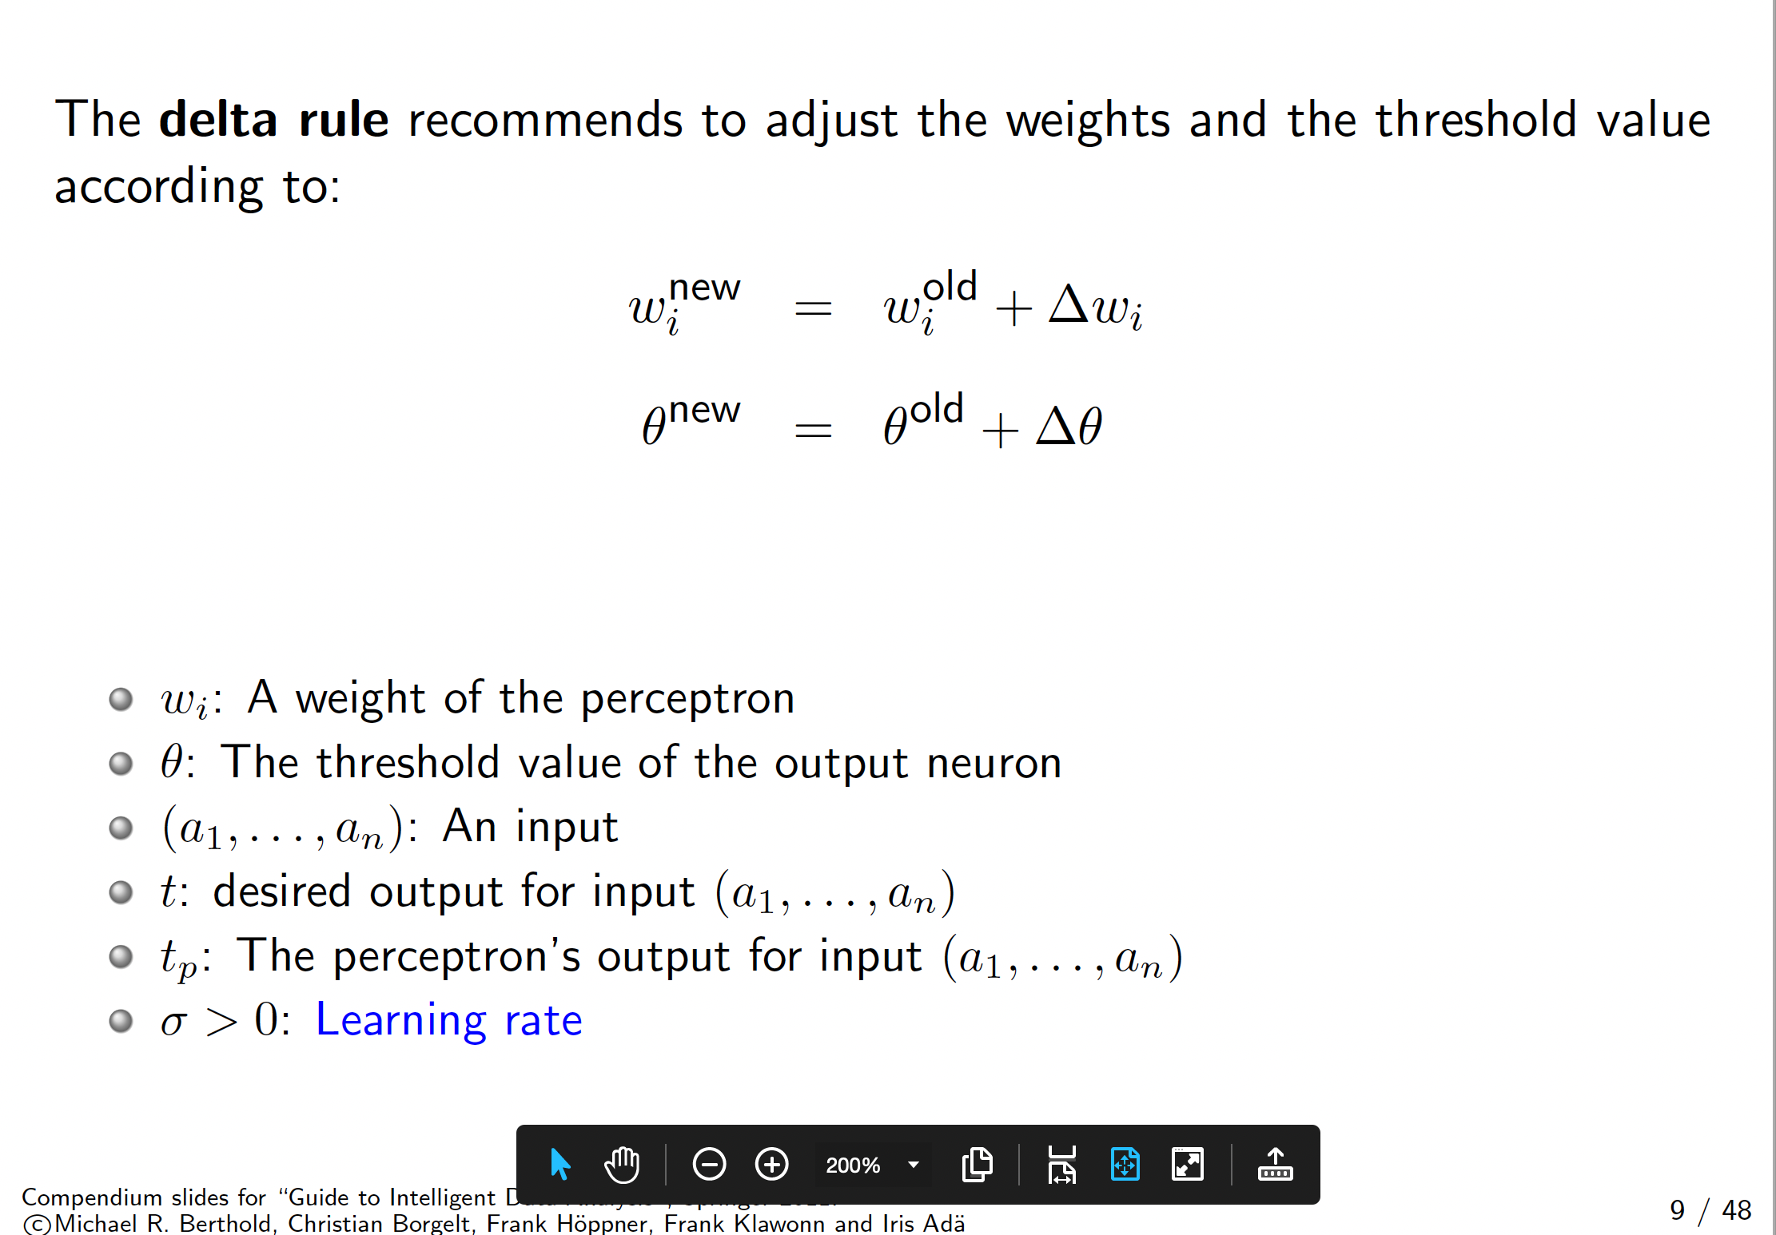
The delta rule

Slide 14
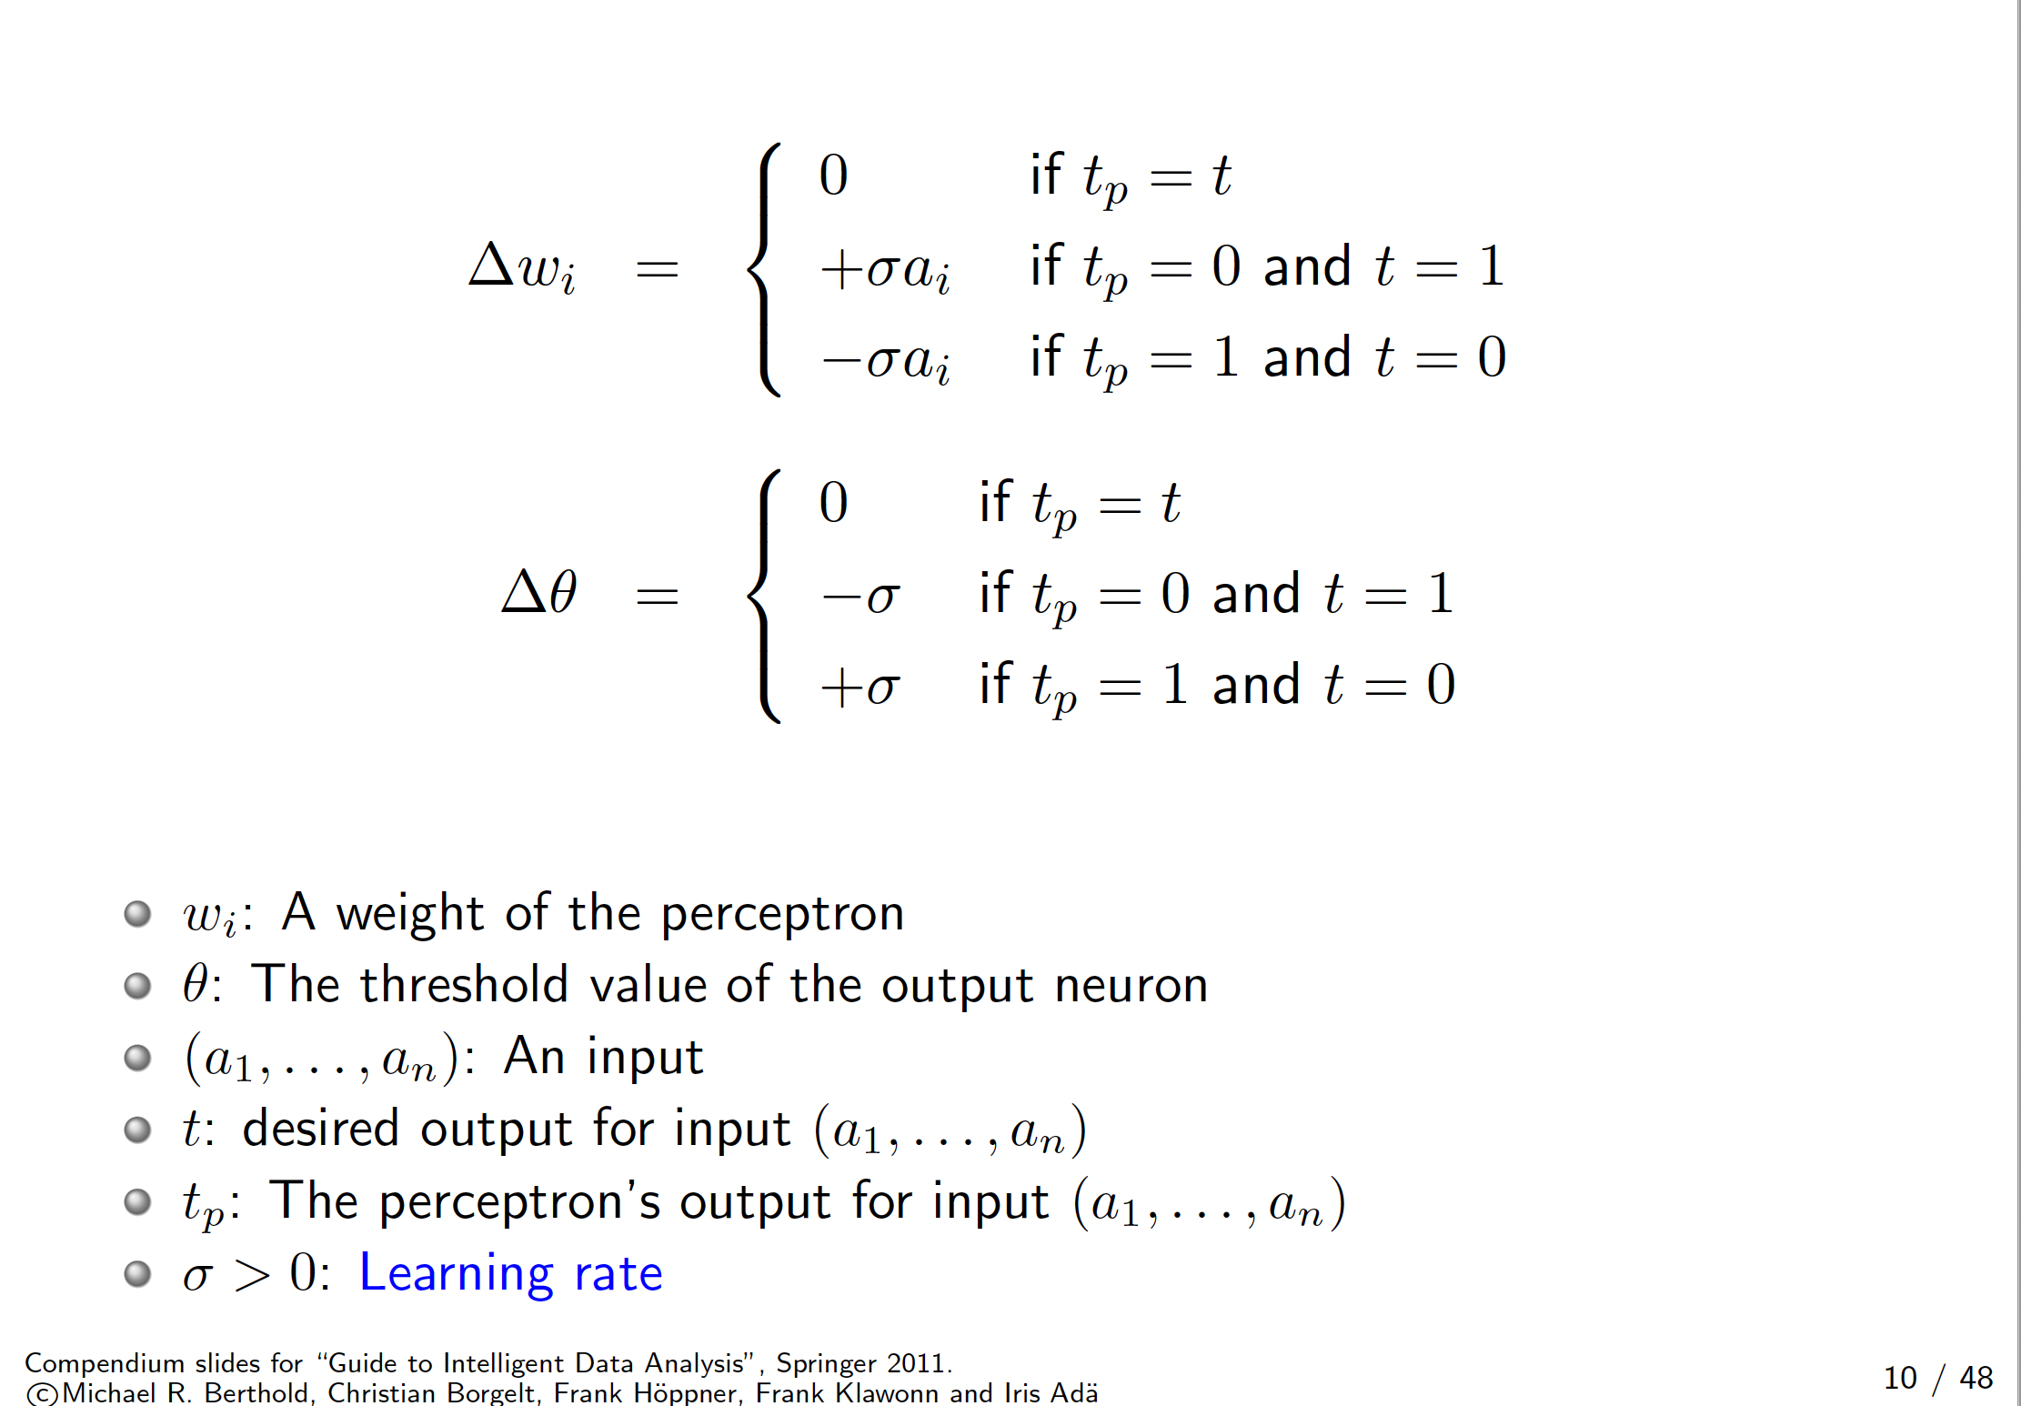
The delta rule

Slide 15
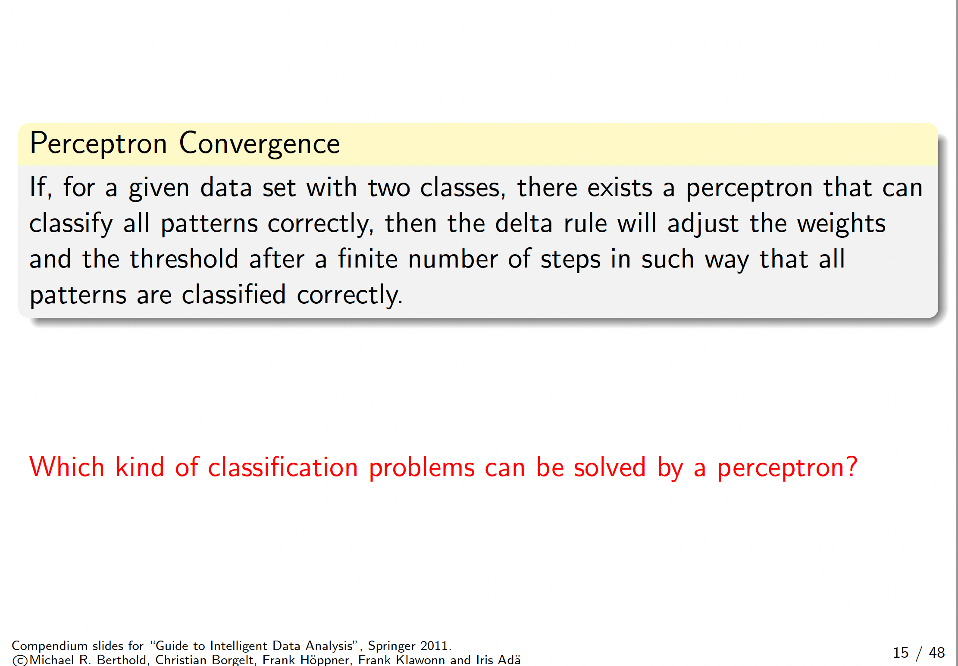
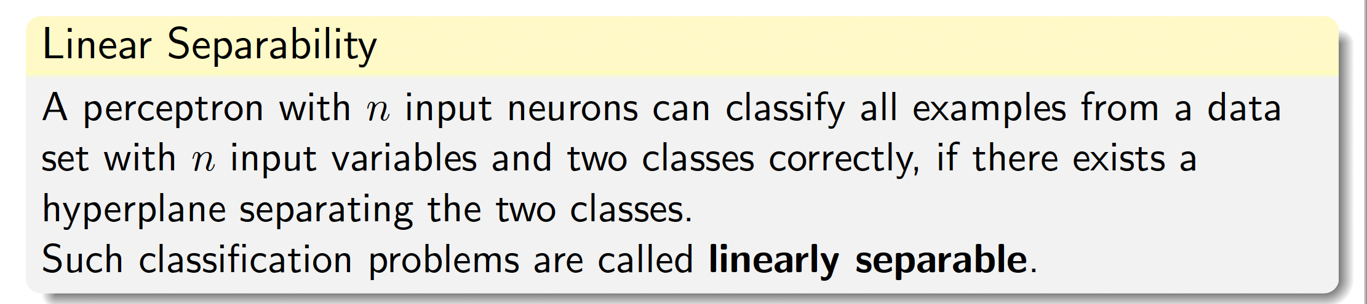
Linear Separability

Slide 16
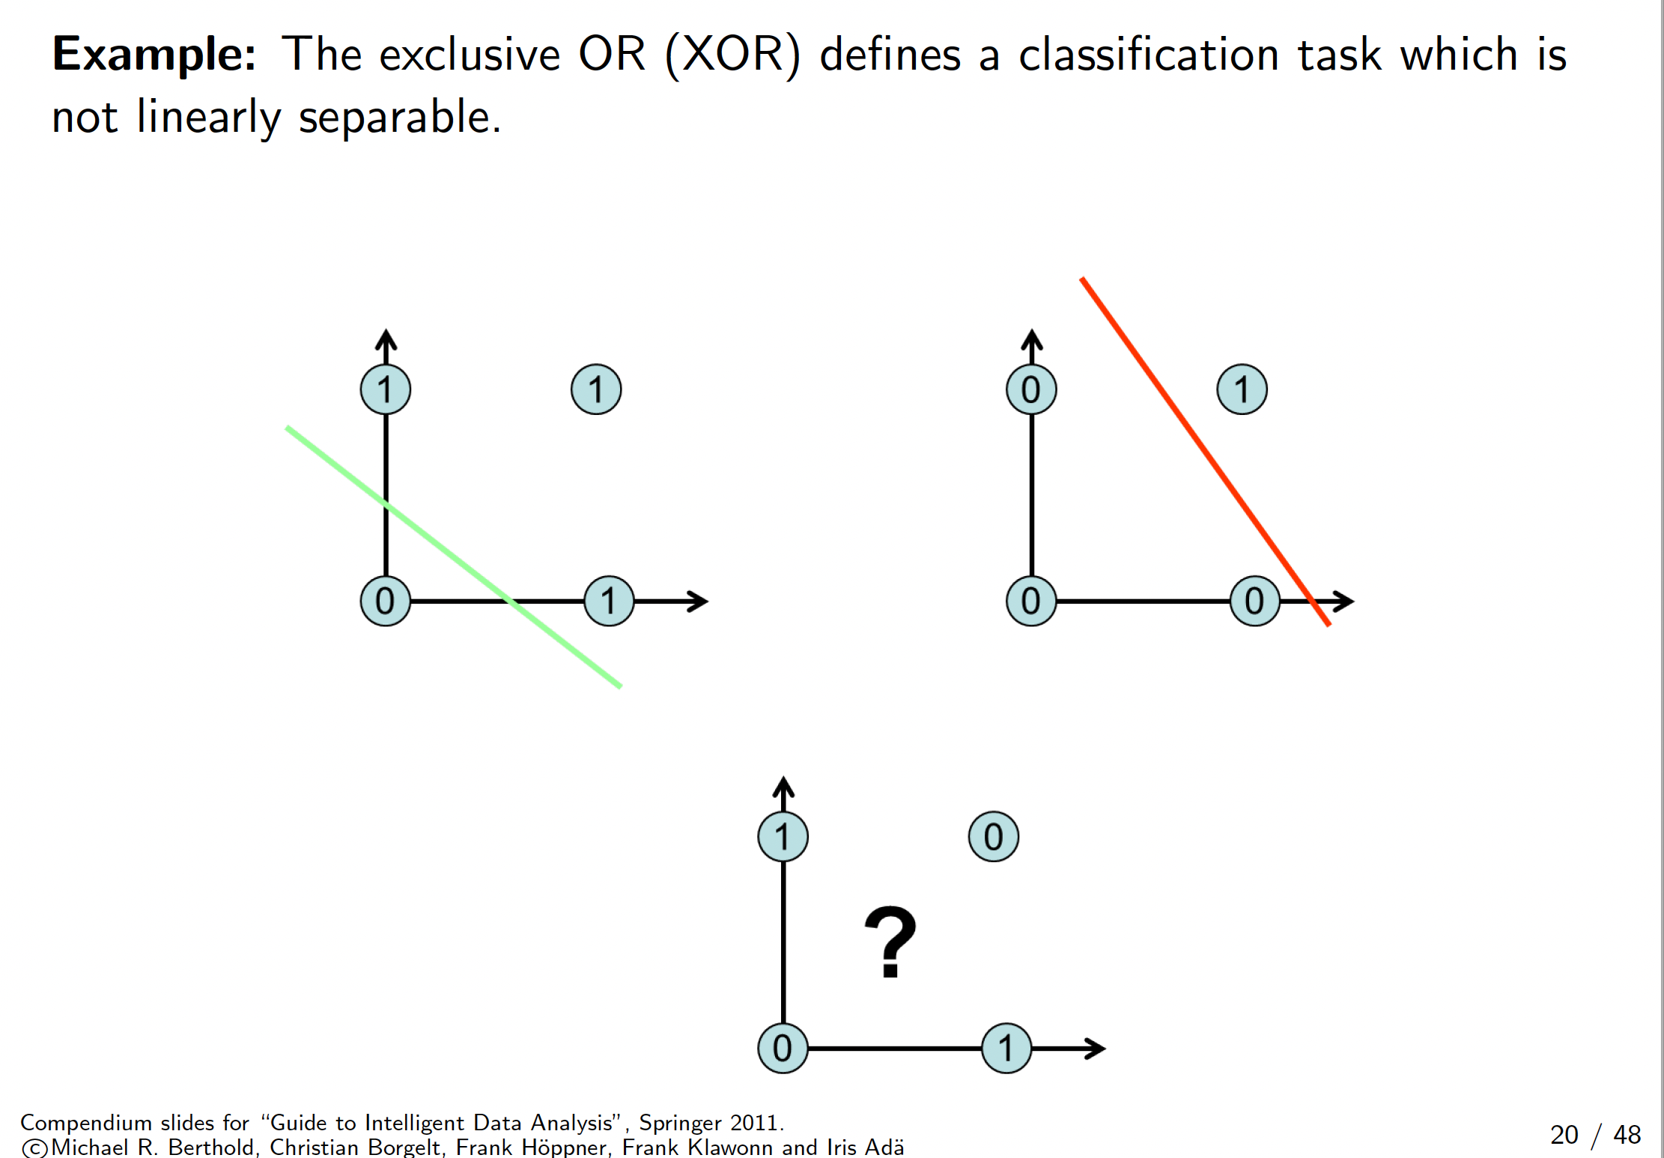

Slide 17
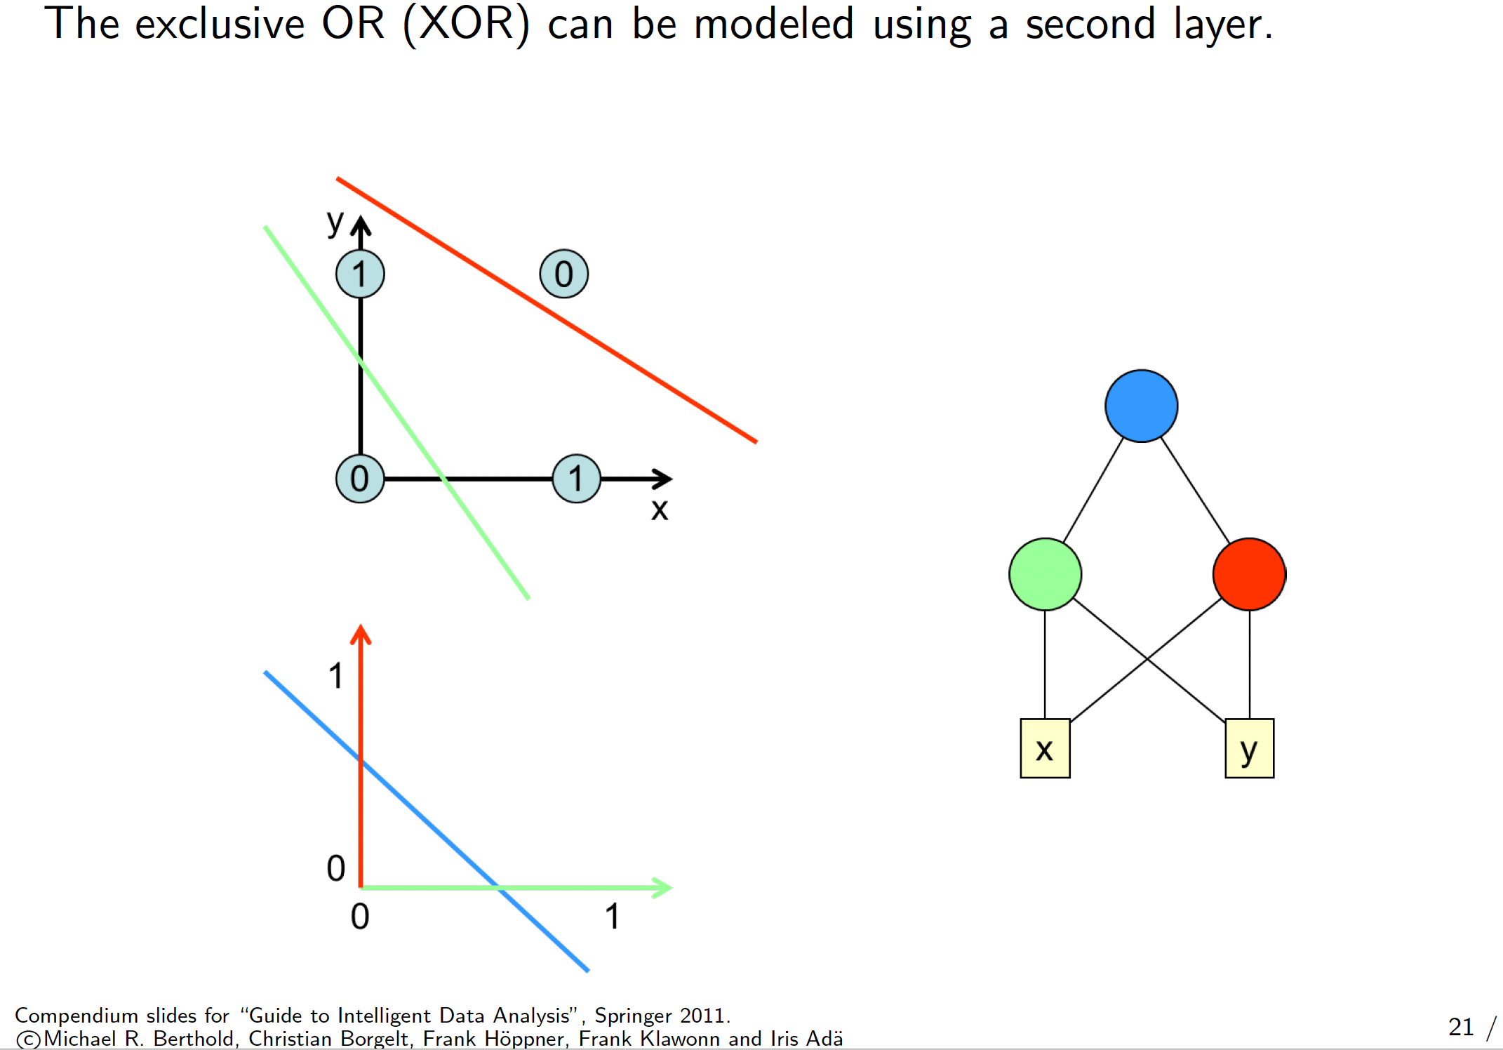

Slide 18
Nonlinearly Separable Data
Since f(w,x) is a linear combination of input variables, decision boundary is linear.
For nonlinearly separable problems, the perceptron fails because no linear hyperplane can separate the data perfectly.
An example of nonlinearly separable data is the XOR function.
XOR Data

Slide 19
Recap:Artificial Neural Networks (ANN)
Output Y is 1 if at least two of the three inputs are equal to 1.

Slide 20
Artificial Neural Networks (ANN)
Notes:
The model is an assembly of inter-connected nodes and weighted links
Output node sums up each of its input value according to the weights of its links
Compare output node against some threshold t or bias b

Slide 21
Artificial Neural Networks (ANN)
The model is a set of interconnected nodes and weighted links.
The output node sums each input value by the weights of its links.
Calculate the value of the output node by
a) comparing it with a threshold t (also called bias)
b)MINIMISE THE ERROR
All in many 'backward' and 'forward' steps

Slide 22
Characterizing the Artificial Neuron
Input/Output signal may be.
Real value.
Unipolar {0, 1}.
Bipolar {-1, +1}.
Weight (w or sigma): θ_{ij} – strength of connection from unit j to unit i
Learning amounts to adjusting the weights θ_{ij} by means of an optimization algorithm aiming to minimize a cost function,
i.e., as in biological systems training a perceptron model amounts to adapting the weights of the links until they fit the input output relationships of the underlying data.

Slide 23
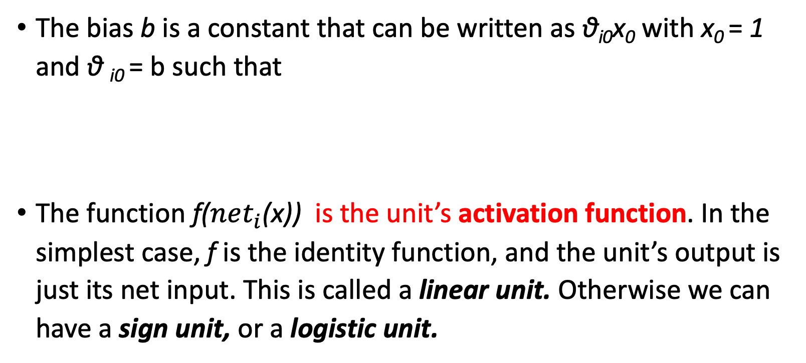
Characterizing the Artificial Neuron
The bias b is a constant that can be written as θ_{i0}x₀ with x₀ = 1 and θ _{i0} = b such that
The function f($net_{i}$(x)) is the unit’s activation function. In the simplest case, f is the identity function, and the unit’s output is just its net input. This is called a linear unit. Otherwise we can have a sign unit, or a logistic unit.
$$net_{i}=\sum_{j=0}^{n}{{\text{θ}}_{ij}x_{j}}$$

Slide 24
A Simple Linear Neuron
Linear activation function
net
Output
y
θ₀
x₀=1
Bias unit
θ₁
θ₂
θ₃
θ_{M}
weights
x₁
x₂
x₃
…
x_{M}
Input
Notes:
A perceptron computes its output by performing a weighted sum on its inputs, subtracting a bias factor from the sum and the examining the sign of the result.

Slide 25
Linear Threshold Unit (a.k.a. Perceptron)
Sign activation function
net
y
$$σ\left(a\right)=\left\{\begin{aligned}+1 a≥0 \\ −1 a<0\end{aligned}\right.$$
Output
where
θ₀
x₀=1
Bias unit
θ₁
θ₂
θ₃
θ_{M}
weights
x₁
x₂
x₃
…
x_{M}
Input
Notes:
A perceptron computes its output by performing a weighted sum on its inputs, subtracting a bias factor from the sum and the examining the sign of the result.

Slide 26
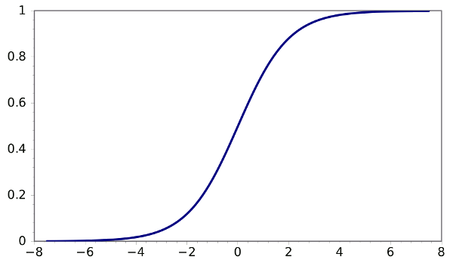
The Logistic Neuron
Sigmoid logistic activation function
net
Output
y
θ₀
x₀=1
Bias unit
θ₁
θ₂
θ₃
θ_{M}
weights
x₁
x₂
x₃
…
x_{M}
Input

Slide 27
Perceptron
Single layer network
Contains only input and output nodes
Activation function: f = sign(w•x)
Applying model is straightforward
X₁ = 1, X₂ = 0, X₃ =1 => y = sign(0.2) = 1

Slide 28
Learning Iterative Procedure
During the training phase the weight parameters are adjusted until the outputs of the perceptron become consistent with the true outputs of the training examples.
Initialize the weights (w₀, w₁, …, w_{m})
Repeat
For each training example (x_{i}, y_{i})
Compute f(w^{(k)}, x_{i})
Update the weights:
Until stopping condition is met
Iteration index
Learning rate
Notes:
The new weight is a combination of the old weight and a term proportional to the prediction error. If the prediction is correct the weight remains unchanged.

Slide 29
Perceptron Learning Rule
Weight update formula:
Intuition:
Update weight based on error:
If y=f(x,w), e=0: no update needed
If y>f(x,w), e=2: weight must be increased so that f(x,w) will increase
If y<f(x,w), e=-2: weight must be decreased so that f(x,w) will decrease

Slide 30
The Learning Rate
Is a parameter with value between 0 and 1 used to control the amount of adjustment made in each iteration.
If is close to 0 the new weight is mostly influenced by the value of the old weight.
If it is close to 1, then the new weight is mostly influenced by the current adjustment.
The learning rate can be adaptive: initially moderately large and the gradually decreases in subsequent iterations.

Slide 31
Exercises - Perceptron

Slide 32
Predict with Perceptron
W₁= 0.4
id | X₁ | X₂ | X₃ | Y
1 | 0 | 0 | 0
2 | 1 | 1 | 1
3 | 1 | 0 | 1
4 | 0 | 2 | 0
f=sign
W₂= -1.5
W₃= -0.1
W₀= 1

Slide 33
Predict with Perceptron - Solution
W₁= 0.4
id | X₁ | X₂ | X₃ | Y
1 | 0 | 0 | 0 | 1
2 | 1 | 1 | 1 | -1
3 | 1 | 0 | 1 | 1
4 | 0 | 2 | 0 | -1
f=sign
W₂= -1.5
W₃= -0.1
W₀= 1
Y₁ = sign(1 + 0.4 * 0 + -1.5 * 0 + -0.1 * 0) = sign(1) = 1
Y₂ = sign(1 + 0.4 * 1 + -1.5 * 1 + -0.1 * 1) = sign(-0.2) = -1
Y₃ = sign(1 + 0.4 * 1 + -1.5 * 0 + -0.1 * 0) = sign(1.3) = 1
Y₄ = sign(1 + 0.4 * 0 + -1.5 * 2 + -0.1 * 0) = sign(-2) = -1

Slide 34
Train Linear Perceptron
id | X₁ | X₂ | Y
a | 0 | 1 | -1
b | 0 | 0 | 1
c | 1 | 2 | -1
it | W₀ | W₁ | W₂ | X.W | f(X.W) | error | delta₀ | delta₁ | delta₂
1 | -1 | 0 | 0
2
3
4
5
6
7
8
9
10
11
12
Lambda = 0.3
f = sign

Slide 35
Train Linear Perceptron
id | X₁ | X₂ | Y
a | 0 | 1 | -1
b | 0 | 0 | 1
c | 1 | 2 | -1
it | W₀ | W₁ | W₂ | X.W | f(X.W) | error | delta₀ | delta₁ | delta₂
1 | -1 | 0 | 0 | -1
2
3
4
5
6
7
8
9
10
11
12
Lambda = 0.3
f = sign

Slide 36
Train Linear Perceptron
id | X₁ | X₂ | Y
a | 0 | 1 | -1
b | 0 | 0 | 1
c | 1 | 2 | -1
it | W₀ | W₁ | W₂ | X.W | f(X.W) | error | delta₀ | delta₁ | delta₂
1 | -1 | 0 | 0 | -1 | -1
2
3
4
5
6
7
8
9
10
11
12
Lambda = 0.3
f = sign

Slide 37
Train Linear Perceptron
id | X₁ | X₂ | Y
a | 0 | 1 | -1
b | 0 | 0 | 1
c | 1 | 2 | -1
it | W₀ | W₁ | W₂ | X.W | f(X.W) | error | delta₀ | delta₁ | delta₂
1 | -1 | 0 | 0 | -1 | -1 | 0
2
3
4
5
6
7
8
9
10
11
12
Lambda = 0.3
f = sign

Slide 38
Train Linear Perceptron
id | X₁ | X₂ | Y
a | 0 | 1 | -1
b | 0 | 0 | 1
c | 1 | 2 | -1
it | W₀ | W₁ | W₂ | X.W | f(X.W) | error | delta₀ | delta₁ | delta₂
1 | -1 | 0 | 0 | -1 | -1 | 0 | 0
2
3
4
5
6
7
8
9
10
11
12
Lambda = 0.3
f = sign

Slide 39
Train Linear Perceptron
id | X₁ | X₂ | Y
a | 0 | 1 | -1
b | 0 | 0 | 1
c | 1 | 2 | -1
it | W₀ | W₁ | W₂ | X.W | f(X.W) | error | delta₀ | delta₁ | delta₂
1 | -1 | 0 | 0 | -1 | -1 | 0 | 0 | 0 | 0
2
3
4
5
6
7
8
9
10
11
12
Lambda = 0.3
f = sign

Slide 40
Train Linear Perceptron
id | X₁ | X₂ | Y
a | 0 | 1 | -1
b | 0 | 0 | 1
c | 1 | 2 | -1
it | W₀ | W₁ | W₂ | X.W | f(X.W) | error | delta₀ | delta₁ | delta₂
1 | -1 | 0 | 0 | -1 | -1 | 0 | 0 | 0 | 0
2
3
4
5
6
7
8
9
10
11
12
Lambda = 0.3
f = sign

Slide 41
Train Linear Perceptron
id | X₁ | X₂ | Y
a | 0 | 1 | -1
b | 0 | 0 | 1
c | 1 | 2 | -1
it | W₀ | W₁ | W₂ | X.W | f(X.W) | error | delta₀ | delta₁ | delta₂
1 | -1 | 0 | 0 | -1 | -1 | 0 | 0 | 0 | 0
2 | -1
3
4
5
6
7
8
9
10
11
12
Lambda = 0.3
f = sign

Slide 42
Train Linear Perceptron
id | X₁ | X₂ | Y
a | 0 | 1 | -1
b | 0 | 0 | 1
c | 1 | 2 | -1
it | W₀ | W₁ | W₂ | X.W | f(X.W) | error | delta₀ | delta₁ | delta₂
1 | -1 | 0 | 0 | -1 | -1 | 0 | 0 | 0 | 0
2 | -1 | 0
3
4
5
6
7
8
9
10
11
12
Lambda = 0.3
f = sign

Slide 43
Train Linear Perceptron
id | X₁ | X₂ | Y
a | 0 | 1 | -1
b | 0 | 0 | 1
c | 1 | 2 | -1
it | W₀ | W₁ | W₂ | X.W | f(X.W) | error | delta₀ | delta₁ | delta₂
1 | -1 | 0 | 0 | -1 | -1 | 0 | 0 | 0 | 0
2 | -1 | 0 | 0
3
4
5
6
7
8
9
10
11
12
Lambda = 0.3
f = sign

Slide 44
Train Linear Perceptron
id | X₁ | X₂ | Y
a | 0 | 1 | -1
b | 0 | 0 | 1
c | 1 | 2 | -1
it | W₀ | W₁ | W₂ | X.W | f(X.W) | error | delta₀ | delta₁ | delta₂
1 | -1 | 0 | 0 | -1 | -1 | 0 | 0 | 0 | 0
2 | -1 | 0 | 0 | -1
3
4
5
6
7
8
9
10
11
12
Lambda = 0.3
f = sign

Slide 45
Train Linear Perceptron
id | X₁ | X₂ | Y
a | 0 | 1 | -1
b | 0 | 0 | 1
c | 1 | 2 | -1
it | W₀ | W₁ | W₂ | X.W | f(X.W) | error | delta₀ | delta₁ | delta₂
1 | -1 | 0 | 0 | -1 | -1 | 0 | 0 | 0 | 0
2 | -1 | 0 | 0 | -1 | -1
3
4
5
6
7
8
9
10
11
12
Lambda = 0.3
f = sign

Slide 46
Train Linear Perceptron
id | X₁ | X₂ | Y
a | 0 | 1 | -1
b | 0 | 0 | 1
c | 1 | 2 | -1
it | W₀ | W₁ | W₂ | X.W | f(X.W) | error | delta₀ | delta₁ | delta₂
1 | -1 | 0 | 0 | -1 | -1 | 0 | 0 | 0 | 0
2 | -1 | 0 | 0 | -1 | -1 | 2
3
4
5
6
7
8
9
10
11
12
Lambda = 0.3
f = sign

Slide 47
Train Linear Perceptron
id | X₁ | X₂ | Y
a | 0 | 1 | -1
b | 0 | 0 | 1
c | 1 | 2 | -1
it | W₀ | W₁ | W₂ | X.W | f(X.W) | error | delta₀ | delta₁ | delta₂
1 | -1 | 0 | 0 | -1 | -1 | 0 | 0 | 0 | 0
2 | -1 | 0 | 0 | -1 | -1 | 2 | 0.6
3
4
5
6
7
8
9
10
11
12
Lambda = 0.3
f = sign

Slide 48
Train Linear Perceptron
id | X₁ | X₂ | Y
a | 0 | 1 | -1
b | 0 | 0 | 1
c | 1 | 2 | -1
it | W₀ | W₁ | W₂ | X.W | f(X.W) | error | delta₀ | delta₁ | delta₂
1 | -1 | 0 | 0 | -1 | -1 | 0 | 0 | 0 | 0
2 | -1 | 0 | 0 | -1 | -1 | 2 | 0.6 | 0
3
4
5
6
7
8
9
10
11
12
Lambda = 0.3
f = sign

Slide 49
Train Linear Perceptron
id | X₁ | X₂ | Y
a | 0 | 1 | -1
b | 0 | 0 | 1
c | 1 | 2 | -1
it | W₀ | W₁ | W₂ | X.W | f(X.W) | error | delta₀ | delta₁ | delta₂
1 | -1 | 0 | 0 | -1 | -1 | 0 | 0 | 0 | 0
2 | -1 | 0 | 0 | -1 | -1 | 2 | 0.6 | 0 | 0
3
4
5
6
7
8
9
10
11
12
Lambda = 0.3
f = sign

Slide 50
Train Linear Perceptron
id | X₁ | X₂ | Y
a | 0 | 1 | -1
b | 0 | 0 | 1
c | 1 | 2 | -1
it | W₀ | W₁ | W₂ | X.W | f(X.W) | error | delta₀ | delta₁ | delta₂
1 | -1 | 0 | 0 | -1 | -1 | 0 | 0 | 0 | 0
2 | -1 | 0 | 0 | -1 | -1 | 2 | 0.6 | 0 | 0
3 | -0.4
4
5
6
7
8
9
10
11
12
Lambda = 0.3
f = sign

Slide 51
Train Linear Perceptron
id | X₁ | X₂ | Y
a | 0 | 1 | -1
b | 0 | 0 | 1
c | 1 | 2 | -1
it | W₀ | W₁ | W₂ | X.W | f(X.W) | error | delta₀ | delta₁ | delta₂
1 | -1 | 0 | 0 | -1 | -1 | 0 | 0 | 0 | 0
2 | -1 | 0 | 0 | -1 | -1 | 2 | 0.6 | 0 | 0
3 | -0.4 | 0 | 0
4
5
6
7
8
9
10
11
12
Lambda = 0.3
f = sign

Slide 52
Train Linear Perceptron - Solution
id | X₁ | X₂ | Y
a | 0 | 1 | -1
b | 0 | 0 | 1
c | 1 | 2 | -1
it | W₀ | W₁ | W₂ | X.W | f(X.W) | error | delta₀ | delta₁ | delta₂
1 | -1 | 0 | 0 | -1 | -1 | 0 | 0 | 0 | 0
2 | -1 | 0 | 0 | -1 | -1 | 2 | 0,6 | 0 | 0
3 | -0,4 | 0 | 0 | -0,4 | -1 | 0 | 0 | 0 | 0
4 | -0,4 | 0 | 0 | -0,4 | -1 | 0 | 0 | 0 | 0
5 | -0,4 | 0 | 0 | -0,4 | -1 | 2 | 0,6 | 0 | 0
6 | 0,2 | 0 | 0 | 0,2 | 1 | -2 | -0,6 | -0,6 | -1,2
7 | -0,4 | -0,6 | -1,2 | -1,6 | -1 | 0 | 0 | 0 | 0
8 | -0,4 | -0,6 | -1,2 | -0,4 | -1 | 2 | 0,6 | 0 | 0
9 | 0,2 | -0,6 | -1,2 | -2,8 | -1 | 0 | 0 | 0 | 0
10 | 0,2 | -0,6 | -1,2 | -1 | -1 | 0 | 0 | 0 | 0
11 | 0,2 | -0,6 | -1,2 | 0,2 | 1 | 0 | 0 | 0 | 0
12 | 0,2 | -0,6 | -1,2 | -2,8 | -1 | 0 | 0 | 0 | 0
Lambda = 0.3
f = sign

Slide 53
Example of Perceptron Learning

Slide 54
(Deep) Neural Networks

Slide 55
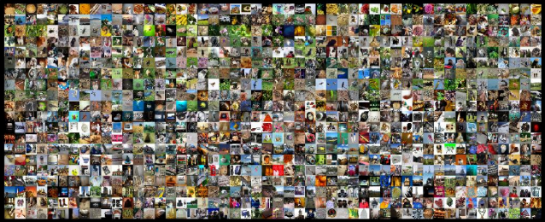

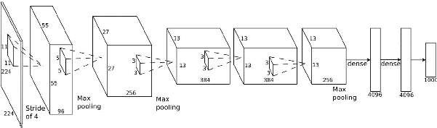
Why Now?
(Big) Data
GPU
Theory

Slide 56
A quick look on Deep Learning
AI
Machine Learning
Repres.
Learning
Deep Learning

Slide 57

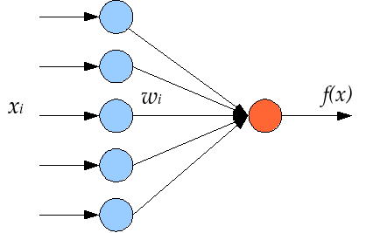
Deep learning
Repres.
Learning
Representation learning methods that
allow a machine to be fed with raw data and
to automatically discover the representations needed for detection or classification.
Deep Learning
Raw representation
Higher-level representation
Age
Weight
Income
Children
Likes sport
Likes reading
Education
…
35
65
23 k€
2
0.3
0.6
high
…
Young parent
Fit sportsman
High-educated reader
Rich obese
…
0.9
0.1
0.8
0.0
…

Slide 58

Multiple Levels Of Abstraction

Slide 59
Nonlinearly Separable Data
Since f(w,x) is a linear combination of input variables, decision boundary is linear.
For nonlinearly separable problems, the perceptron fails because no linear hyperplane can separate the data perfectly.
An example of nonlinearly separable data is the XOR function.
XOR Data

Slide 60
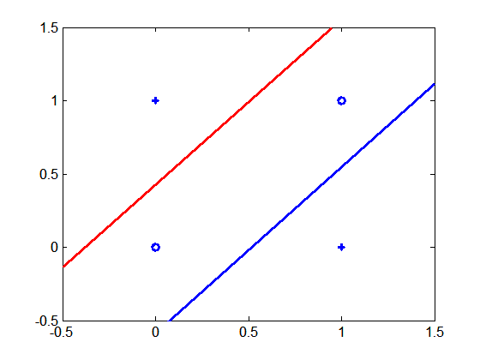
Multilayer Neural Network
Hidden Layers: intermediary layers between input and output layers.
More general activation functions (sigmoid, linear, hyperbolic tangent, etc.).
Multi-layer neural network can solve any type of classification task involving nonlinear decision surfaces.
Perceptron is single layer.
We can think to each hidden node as a perceptron that tries to construct one hyperplane, while the output node combines the results to return the decision boundary.
XOR Data

Slide 61
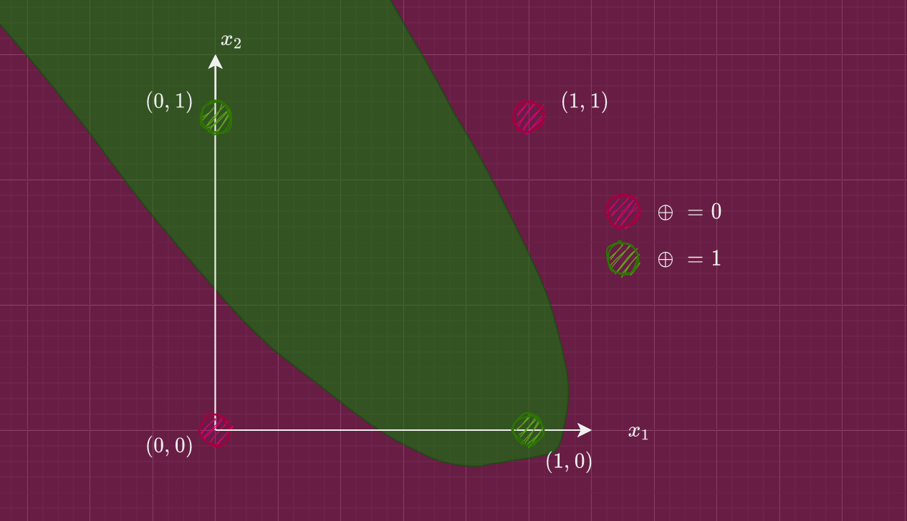

Slide 62
General Structure of ANN
Training ANN means learning the weights of the neurons

Slide 63
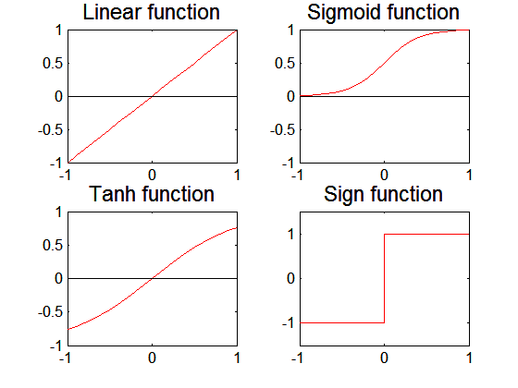
Artificial Neural Networks (ANN)
Various types of neural network topology
single-layered network (perceptron) versus multi-layered network
Feed-forward versus recurrent network
Various types of activation functions (f)

Slide 64
Deep Neural Networks
Output
y
Hidden Layer 1
a₁
a₂
…
a_{D}
Input
x₁
x₂
x₃
…
x_{M}

Slide 65
Deep Neural Networks
Output
y
Hidden Layer 2
b₁
b₂
…
b_{E}
Hidden Layer 1
a₁
a₂
…
a_{D}
Input
x₁
x₂
x₃
…
x_{M}

Slide 66
Deep Neural Networks
Actually deep learning is way more than having neural networks with a lot of layers
Output
y
Backpropagation through many layers has numerical problems that makes learning not-straightforward (Gradient Vanish/Esplosion)
Hidden Layer 3
c₁
c₂
…
c_{F}
Hidden Layer 2
b₁
b₂
…
b_{E}
Hidden Layer 1
a₁
a₂
…
a_{D}
Input
x₁
x₂
x₃
…
x_{M}

Slide 67
Representation Learning
We don’t know the “right” levels of abstraction of information that is good for the machine
So let the model figure it out!
Example from Honglak Lee (NIPS 2010)

Slide 68
Representation Learning
Face Recognition:
Deep Network can build up increasingly higher levels of abstraction
Lines, parts, regions
Example from Honglak Lee (NIPS 2010)

Slide 69
Representation Learning
Output
y
Hidden Layer 3
c₁
c₂
…
c_{F}
Hidden Layer 2
b₁
b₂
…
b_{E}
Hidden Layer 1
a₁
a₂
…
a_{D}
Input
x₁
x₂
x₃
…
x_{M}
Example from Honglak Lee (NIPS 2010)

Slide 70
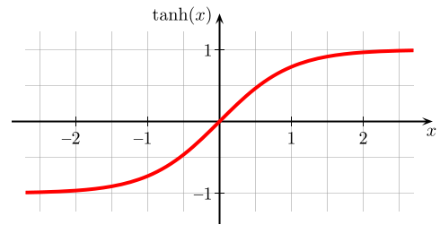
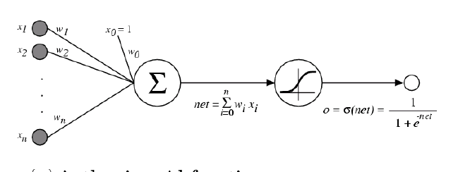
Activation Functions
A new change: modifying the nonlinearity
The logistic is not widely used in modern ANNs
Alternative 1: tanh
Like logistic function but shifted to range [-1, +1]

Slide 71
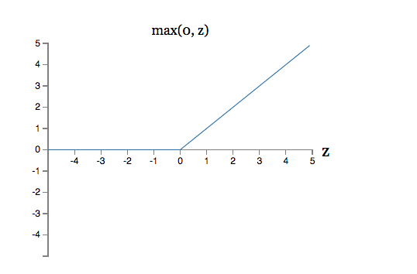

Activation Functions
Alternative 2: rectified linear unit
Linear with a cutoff at zero
(Implementation: clip the gradient when you pass zero)

Slide 72
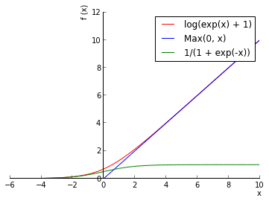
Activation Functions
Alternative 3: soft exponential linear unit
Soft version: log(exp(x)+1)
Doesn’t saturate (at one end)
Sparsifies outputs
Helps with vanishing gradient
Slide from William Cohen

Slide 73
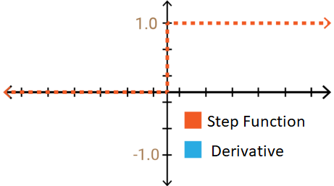
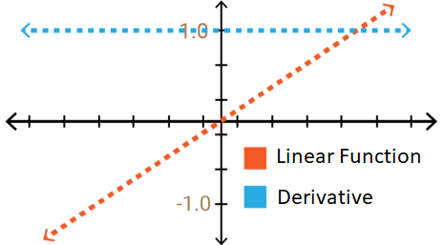
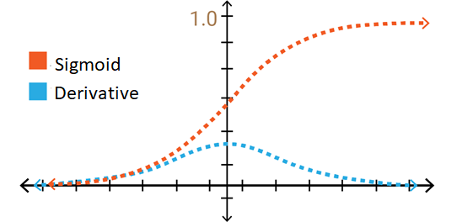
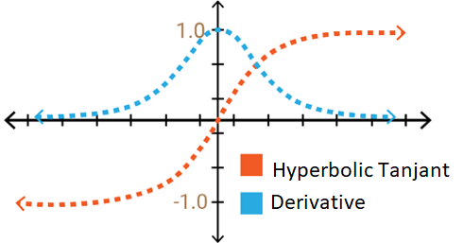
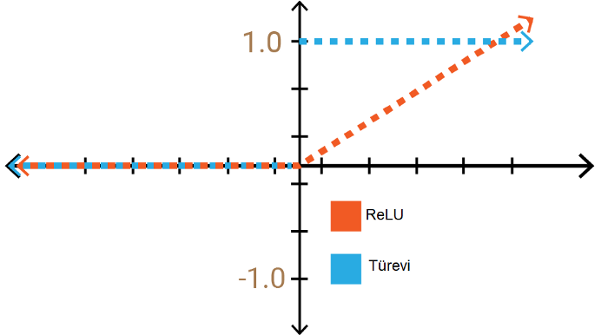
Activation Functions Summary
$$f\left(x\right)=\left\{\begin{matrix}0 for x<0 \\ 1 for x≥0\end{matrix}\right.$$
$$f\left(x\right)=\frac{1}{1+e^{−x}}$$
$$f\left(x\right)=x$$
$$f\left(x_{j}\right)=\frac{e^{x_{j}}}{\sum_{k}{e^{x_{k}}}}$$
Hyperbolic Tangent
Softmax Function
$$f\left(x\right)=\frac{e^{x}−e^{−x}}{e^{x}+e^{−x}}$$
$$f\left(x\right)=\left\{\begin{matrix}0 (or ε) for x<0 \\ x for x≥0\end{matrix}\right.$$

Slide 74
Learning Multi-layer Neural Network
Can we apply perceptron learning to each node, including hidden nodes?
Perceptron computes error e = y-f(w,x) and updates weights accordingly
Problem: how to determine the true value of y for hidden nodes?
Approximate error in hidden nodes by error in the output nodes
Problems:
Not clear how adjustment in the hidden nodes affect overall error
No guarantee of convergence to optimal solution

Slide 75
The delta rule

Slide 76
The delta rule

Slide 77
Gradient Descent for Multilayer NN
2
Quadratic function from which we can find a global minimum solution
y_{i}
Error function to minimize:
Weight update:
Activation function f must be differentiable
For sigmoid function:
Stochastic Gradient Descent (update the weight immediately)
y_{i}
Notes:
The SGD can be used to learn the weights of a multilayer ANN.

Slide 78
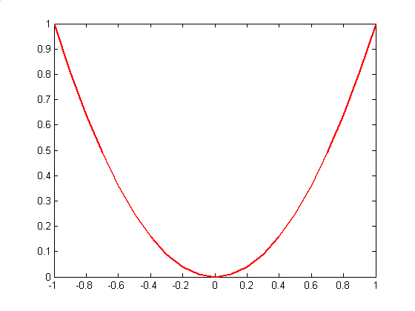
Gradient Descent for Multilayer NN
Weights are updated in the opposite direction of the gradient of the loss function.
Gradient direction is the direction of uphill of the error function.
By taking the negative we are going downhill.
Hopefully to a minimum of the error.
Gradient direction
w^{(k)}
w^{(k+1)}

Slide 79
Gradient Descent for Multilayer NN
For output neurons, weight update formula is the same as before (gradient descent for perceptron)
For hidden neurons:

Slide 80
Training Multilayer NN
Output
y
Hidden Layer
z₁
z₂
…
z_{D}
Input
x₁
x₂
x₃
…
x_{M}

Slide 81
Training Multilayer NN
E
E$(y,y^{∗})$
Output
y
Hidden Layer
z₁
z₂
…
z_{D}
Input
x₁
x₂
x₃
…
x_{M}
How do we update these weights given the loss is available only at the output unit?
Notes:
For hidden nodes, the computation is not trivial because it is difficult to asses the error term without knowing what their output values should be.
Back-propagation solves this problem.

Slide 82
Error Backpropagation
Error is computed at the output and propagated back to the input by chain rule to compute the contribution of each weight (a.k.a. derivative) to the loss
E$(y,y^{∗})$
Output
y
z₁
z₂
…
z_{D}
A 2-step process
Forward pass - Compute the network output
Backward pass – Compute the loss function gradients and update
Hidden Layer
Input
x₁
x₂
x₃
…
x_{M}
https://mattmazur.com/2015/03/17/a-step-by-step-backpropagation-example/
Notes:
For hidden nodes, the computation is not trivial because it is difficult to asses the error term without knowing what their output values should be.
Back-propagation solves this problem.
The forward phase the weights obtained from previous iteration are used to compute the the output value for each neuron in the network.
The computation progresses in the forward direction: the output from layer k is used to compute outputs at level k+1.
During the backward phase the weight update formula is applied in the reverse direction: weights at level k+1 are updated before the weights at level k are updated.
This allows to use the error s for neurons at layer k+1 to estimate the errors for neurons at layer k.

Slide 83
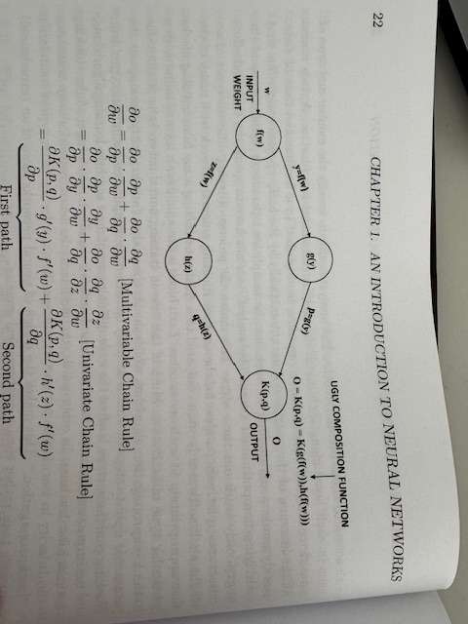
remaind CHAIN RULE

Slide 84
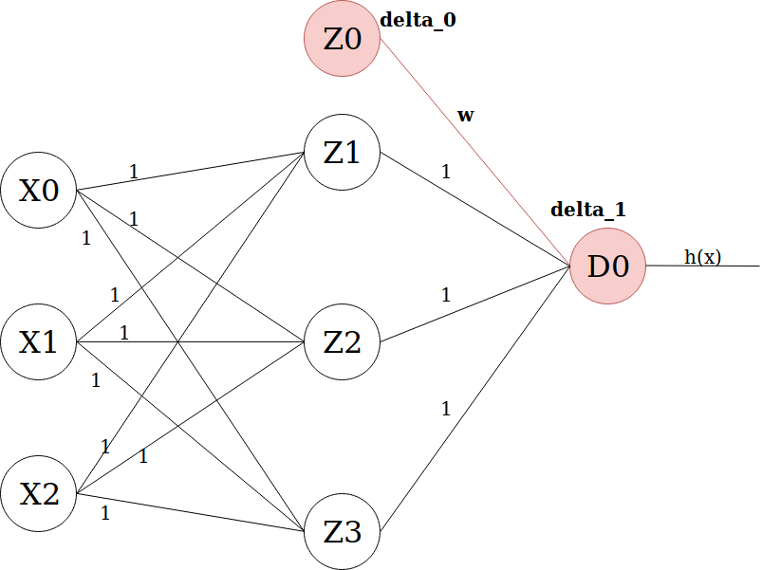
Backpropagation in other words
In order to get the loss of a node (e.g. Z0), we multiply the value of its corresponding f’(z) by the loss of the node it is connected to in the next layer (delta_1), by the weight of the link connecting both nodes.
We do the delta calculation step at every unit, back-propagating the loss into the neural net, and finding out what loss every node/unit is responsible for.
https://towardsdatascience.com/how-does-back-propagation-in-artificial-neural-networks-work-c7cad873ea7

Slide 85
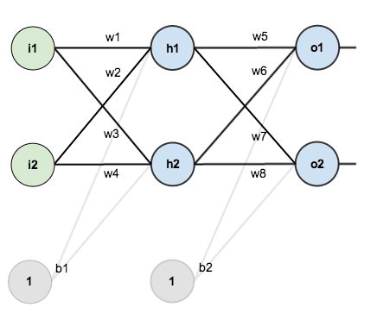
Error Backpropagation - Example

Slide 86
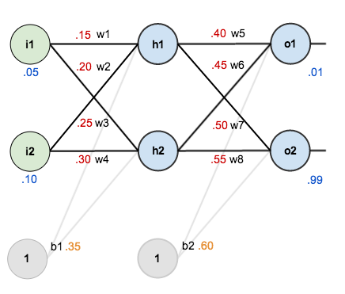
Error Backpropagation - Example
The goal of backpropagation is to optimize the weights so that the neural network can learn how to correctly map arbitrary inputs to outputs.

Slide 87
Error Backpropagation - Example
initial weights
biases
training inputs/outputs
activation: logistic

Slide 88
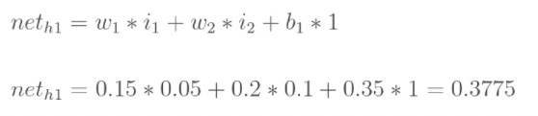
Example - The Forward Pass →

Slide 89

Example - The Forward Pass →

Slide 90

Example - The Forward Pass →

Slide 91
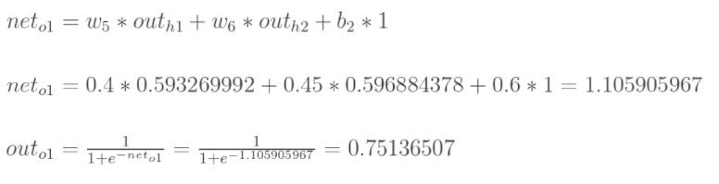

Example - The Forward Pass →

Slide 92


Example – Calculating the Total Error

Slide 93
Example - The Backward Pass ←
How much a change in w5 affects the total error?

Slide 94

Example - The Backward Pass ←

Slide 95
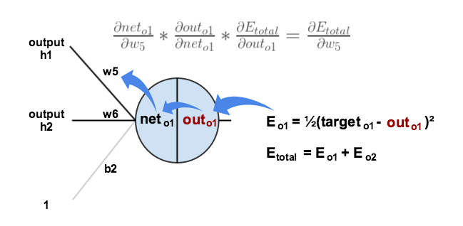
Example - The Backward Pass ←

Slide 96
Example - The Backward Pass ←
how much does the total error change with respect to the output?

Slide 97
Example - The Backward Pass ←
how much does the total error change with respect to the output?

Slide 98
Example - The Backward Pass ←
how much does the total error change with respect to the output?

Slide 99
Example - The Backward Pass ←
how much does the total error change with respect to the output?

Slide 100
Example - The Backward Pass ←
how much does the output o1 change with respect to its total net input?

Slide 101

Example - The Backward Pass ←
how much does the output o1 change with respect to its total net input?

Slide 102
Example - The Backward Pass ←
how much does the output o1 change with respect to its total net input?

Slide 103
Example - The Backward Pass ←
how much does the total net input of o1 change with respect to w5?

Slide 104
Example - The Backward Pass ←
how much does the total net input of o1 change with respect to w5?

Slide 105
Example - The Backward Pass ←
how much does the total net input of o1 change with respect to w5?

Slide 106
Example - The Backward Pass ←
Put everything together

Slide 107
Example - The Backward Pass ←
Slope of the Activation Function obtained as partial derivative by the Gradient Descent
Rewriting as delta rule

Slide 108

Example - The Backward Pass ←
Rewriting as delta rule

Slide 109
Example - The Backward Pass ←
Rewriting as delta rule

Slide 110

Example - The Backward Pass ←
Rewriting as delta rule

Slide 111
Example - The Backward Pass ←
Apply the step size to update w5.

Slide 112
Example - The Backward Pass ←
Apply the step size to update w5.

Slide 113
Example - The Backward Pass ←
The same calculus is applied to update w6, w7 and w8

Slide 114
Example - The Backward Pass ←
After that w5, w6, w7 and w8 have been updated we continue backwards to update w1, w2, w,3 and w4

Slide 115

Example - The Backward Pass ←
After that w5, w6, w7 and w8 have been updated we continue backwards to update w1, w2, w,3 and w4

Slide 116
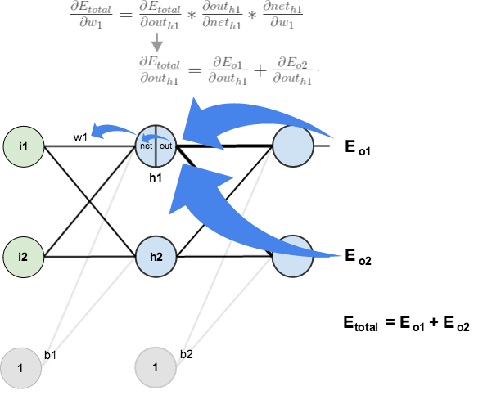
Example - The Backward Pass ←

Slide 117
Example - The Backward Pass ←

Slide 118
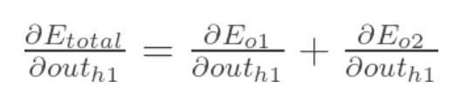
Example - The Backward Pass ←

Slide 119
Example - The Backward Pass ←

Slide 120
Example - The Backward Pass ←

Slide 121
Example - The Backward Pass ←

Slide 122
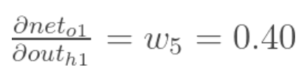
Example - The Backward Pass ←

Slide 123
Example - The Backward Pass ←

Slide 124

Example - The Backward Pass ←
Same process is followed for

Slide 125
Example - The Backward Pass ←

Slide 126
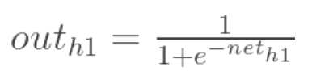
Example - The Backward Pass ←

Slide 127
Example - The Backward Pass ←

Slide 128

Example - The Backward Pass ←

Slide 129

Example - The Backward Pass ←

Slide 130
Example - The Backward Pass ←

Slide 131
Example - The Backward Pass ←

Slide 132
On the Key Importance of Error Functions
The error/loss/cost function reduces all the various good and bad aspects of a possibly complex system down to a single number, a scalar value, which allows candidate solutions to be compared.
It is important, therefore, that the function faithfully represent our design goals.
If we choose a poor error function and obtain unsatisfactory results, the fault is ours for badly specifying the goal of the search.

Slide 133
Objective Functions for NN
Regression: A problem where you predict a real-value quantity.
Output Layer: One node with a linear activation unit.
Loss Function: Quadratic Loss (Mean Squared Error (MSE))
Classification: Classify an example as belonging to one of K classes
Output Layer:
One node with a sigmoid activation unit (K=2)
K output nodes in a softmax layer (K>2)
Loss function: Cross-entropy (i.e. negative log likelihood)
J = E

Slide 134
Design Issues in ANN
Number of nodes in input layer
One input node per binary/continuous attribute
k or log₂k nodes for each categorical attribute with k values
Number of nodes in output layer
One output for binary class problem
k or log₂k nodes for k-class problem
Number of nodes in hidden layer
Initial weights and biases

Slide 135
Characteristics of ANN
Multilayer ANN are universal approximators but could suffer from overfitting if the network is too large.
Gradient descent may converge to local minimum.
Model building can be very time consuming, but testing can be very fast.
Can handle redundant attributes because weights are automatically learnt.
Sensitive to noise in training data.
Difficult to handle missing attributes.

Slide 136
Tips and Tricks of NN Training

Slide 137
Dataset Should Normally be Split Into
Training set: use to update the weights. Records in this set are repeatedly in random order. The weight update equation are applied after a certain number of records.
Validation set: use to decide when to stop training only by monitoring the error and to select the best model configuration
Test set: use to test the performance of the neural network. It should not be used as part of the neural network development and model selection cycle

Slide 138
Before Starting: Weight Initialization
Choice of initial weight values is important as this decides starting position in weight space. That is, how far away from global minimum
Aim is to select weight values which produce midrange function signals
Select weight values randomly from uniform probability distribution
Normalize weight values so number of weighted connections per unit produces midrange function signal
Try different random initialization to
Assess robustness
Have more opportunities to find optimal results

Slide 139
Two learning fashion (plus one)
Sequential mode (on-line, stochastic, or per-pattern)
Weights updated after each records is presented
Many weight updates, can quicker convergence but also make learning less stable
Batch mode (off-line or per-epoch)
Weights updated after all records are presented
Can be very slow and lead to trapping in early local minima
Minibatch mode (a blend of the two above)
Weights updated after a few records (from tens to thousands) are presented
Best of both (and good for GPU)

Slide 140
Minibatch
Minibatch (MB)
MB1
$$\frac{δL_{MB1}}{δw}$$
Training Data
Average gradient on full data
MB2
$$\frac{δL_{MB2}}{δw}$$
…
Stochastic GD sequence-by-sequence
MBn
$$\frac{δL_{MBn}}{δw}$$

Slide 141
Convergence Criteria
Learning is obtained by repeatedly supplying training data and adjusting by backpropagation
Typically 1 training set presentation = 1 epoch
We need a stopping criteria to define convergence
Euclidean norm of the gradient vector reaches a sufficiently small value
Absolute rate of change in the average squared error per epoch is sufficiently small
Validation for generalization performance: stop when generalization performance reaches a peak

Slide 142
Early Stopping
Running too many epochs may overtrain the network and result in overfitting and perform poorly in generalization
Keep a hold-out validation set and test accuracy after every epoch. Maintain weights for best performing network on the validation set and stop training when error increases beyond this
Always let the network run for some epochs before deciding to stop (patience parameter), then backtrack to best result
Validation set
error
Training set
No. of epochs

Slide 143
Model Selection
Too few hidden units prevent the network from learning adequately fitting the data and learning the concept.
Too many hidden units leads to overfitting, unless you regularize heavily (e.g. dropout, weight decay, weight penalties)
Cross validation should be used to determine an appropriate number of hidden units by using the optimal validation error to select the model with optimal number of hidden layers and nodes.
Validation set
error
Training set
No. of epochs

Slide 144
Regularization
Constrain the learning model to avoid overfitting and help improving generalization.
Add penalization terms to the loss function that punish the model for excessive use of resources
Limit the amount of weights that is used to learn a task
Limit the total activation of neurons in the network
$$E^{′}=E\left(y,y^{∗}\right)+λR(⋅)$$
Hyperparameter to be chosen in model selection
$$R(W_{θ})$$
Penalty on parameters
$$R(Z)$$
Penalty on activations

Slide 145
Common penalty terms (norms)
1-norm $||A||_{1}=\sum_{ij}{|a_{ij}|}$
Parameters: $R\left(W_{θ}\right)=||W_{θ}||_{1}^{2}$
Activations: $R\left(Z(X)\right)=||Z\left(X\right)||_{1}^{2}$ (Z hidden unit activation)
2-norm $||A||_{2}=\sqrt{\sum_{ij}{a_{ij}^{2}}}$
Parameters: $R\left(W_{θ}\right)=||W_{θ}||_{2}^{2}$
Activations: $R\left(Z(X)\right)=||Z\left(X\right)||_{2}^{2}$ (Z hidden unit activation)
Any p-norm and more…

Slide 146
Dropout Regularization
Randomly disconnect units from the network during training
…
…

Slide 147
Dropout Regularization
Randomly disconnect units from the network during training
…
…

Slide 148
Dropout Regularization
Randomly disconnect units from the network during training
…
…

Slide 149
Dropout Regularization
Randomly disconnect units from the network during training
x
Regulated by unit dropping hyperparameter
Prevents unit coadaptation
Committee machine effect
Need to adapt prediction phase
Used at prediction time gives predictions with confidence intervals
x
x
…
…
x
x
You can also drop single connections (dropconnect)

Slide 150
Choosing the Optimization Algorithm
Standard Stochastic Gradient Descent (SGD)
Easy and efficient
Difficult to pick up the best learning rate
Unstable convergence
Often used with momentum (exponentially weighted history of previous weights changes)
RMSprop
Adaptive learning rate method (reduces it using a moving average of the squared gradient)
Fastens convergence by having quicker gradients when necessary
Adagrad
Like RMSprop with element-wise scaling of the gradient
ADAM
Like Adagrad but adds an exponentially decaying average of past gradients like momentum

Slide 151
Exercises - Neural Network

Slide 152
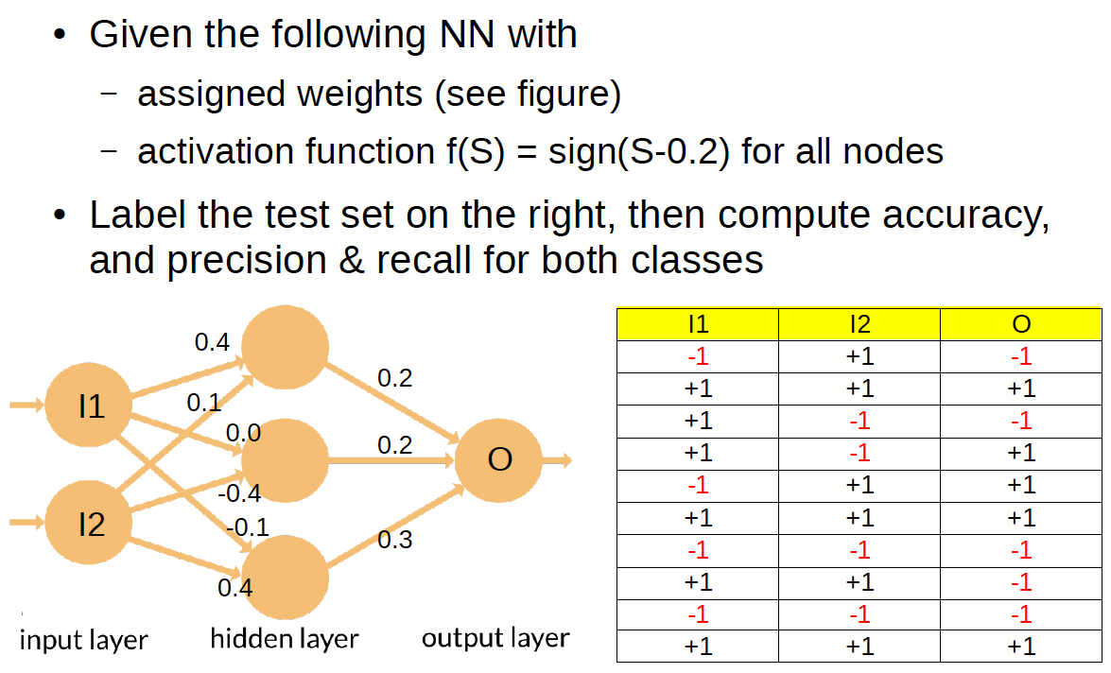
Predict with a Neural Network

Slide 153
Predict with a Neural Network - Solution
H₁ = sign(0.4 * -1 + 0.1 * 1 -0.2) =
= sign(-0.5) = -1
H₂ = sign(0.0 * -1 + -0.4 * 1 -0.2) =
= sign(-0.6) = -1
H₃ = sign(-0.1 * -1 + 0.4 * 1 -0.2) =
= sign(0.3) = 1
Y₁ = sign(0.2 * -1 + 0.2* -1 + 0.3 * 1 -0.2) =
= sign(-0.3) = -1

Slide 154
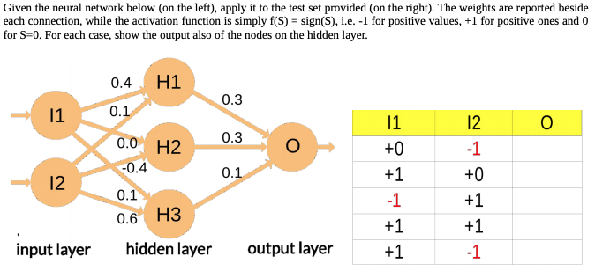
Predict with a Neural Network

Slide 155
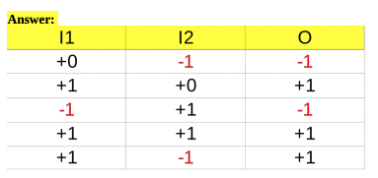
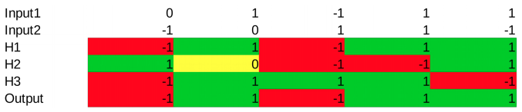
Predict with a Neural Network - Solution

Slide 156
References
Artificial Neural Network. Chapter 5.4 and 5.5. Introduction to Data Mining.
Hands-on Machine Learning with Scikit-Learn, Keras & Tensorflow. A practical handbook to start wrestling with Machine Learning models (2nd ed).
Deep Learning. Ian Goodfellow, Yoshua Bengio, and Aaron Courville. The reference book for deep learning models.

